Slide 1
The PFW Assessment Plan Embedding Assessment in a Culture of Learning
An Integrative View of Teaching, Learning, and Assessment
D. Kent Johnson, PhD

Slide 2


An Assessment Workshop in Two Acts
Act 1: A Philosophy of Assessment as embedded in teaching and learning
Act 2: Developing a Meaningful Assessment Plan at the Program Level

Slide 3
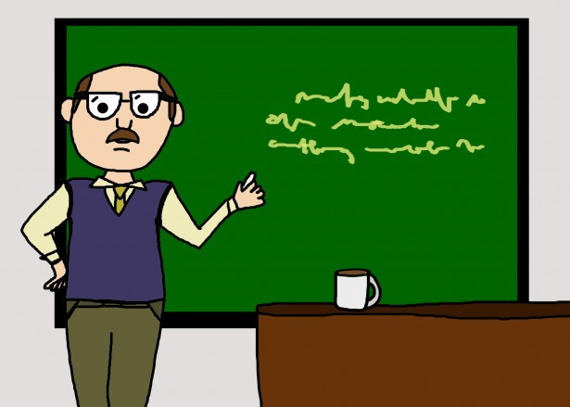

Early lessons on challenges to building a “Culture of Assessment”
That is just that (explicative) TQM – failed for business will fail for HE
SLOs describe our expectations for students. Assessment examines the extent to which our planned learning activities contribute to helping students achieve those expectations and how we might use this information to improve the likelihood students achieve.

Slide 4
Barriers to a Culture of Assessment
History – “…we’ve had these initiatives before, and…”
Time – “…so, I teach four courses, serve two committees, and…”
Training/Knowledge – “…I know my discipline – no one warned me…”
Reward Structure – “…how does this fit in my dossier…”

Slide 5
Reinterpreting Culture of Assessment as Culture of Learning
In context:
A Learning Outcome represents what faculty expect students to know, be able to do, or perhaps value at the end of a specific learning period. (Assignment, Course, Program)
Curricular/Co-Curricular Activities, Student Prior Learning, Engagement, Motivation, Faculty Engagement, etc. are components of the learning environment that can be seen as interventions or treatments
Assessment provides a measure of learning suggesting potential changes in the environment to improve the likelihood students achieve
Therefore: A Culture of Assessment is embedded in a Culture of Learning

Slide 6
Simple Programmatic Assessment Model
Observation
Current State of Knowing
Assessment of at beginning of the curriculum relative to expected SLOs
treatment
Common Learning*
Sequence of learning experiences shared by all students in a program
observation
Student Product
Assessment in context of learning expected as students matriculate through the curriculum
Assessment findings inform curricular change
*core courses, required internships, undergraduate research, etc.

Slide 7
Course Level Assessment Model in a
Quasi-Experimental Framework
Observation
Current State of Knowing
Assessment of current level of knowledge relative to expected SLOs
treatment
Learning Activity
Leading to “product” demonstrating expected learning relative to SLO
observation
Student Product
Assessment in context of expected learning relative to SLOs
Assessment findings inform potential learning strategy change

Slide 8
Some Observations
Returning to my “heckler” from the beginning of the presentation – Faculty believe (rightly so) that they historically assess in an informal way to understand and improve student learning
However, it is often not systematic, focused on “their” course, and often disconnected from the work of other faculty and other courses, out of class learning experiences and student input
The result is a patchwork assessment model of learning that fails to examine how students progress through a program or evaluate what a graduate knows and can do.
So, the focus of Act 2 is examining expectations for graduates to define outcomes

Slide 9

Act 2: Developing a Meaningful Assessment Plan at the Program Level

Slide 10
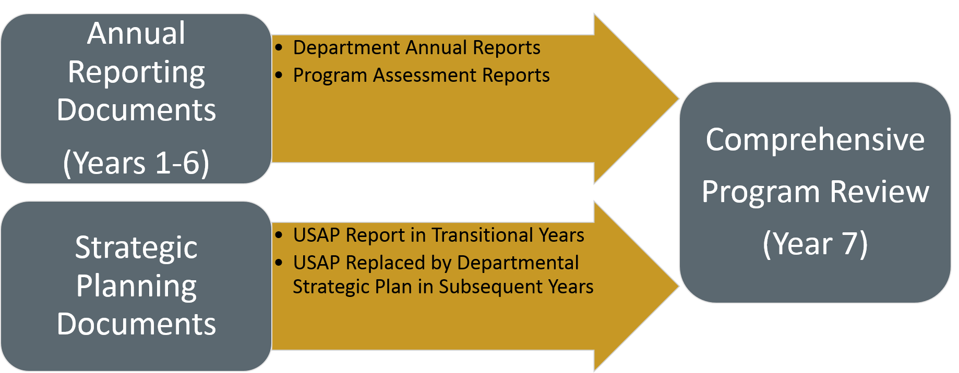
Overview of Comprehensive Program Review

Slide 11
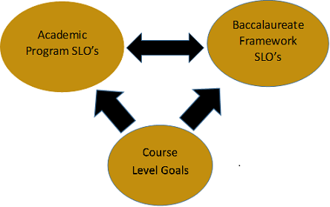
Assessment Framework

Slide 12
An Overview of the Assessment Plan at PFW
(Annual Assessment Report)
Annual Assessment Report Outline:
SLO’s for the Program
Curriculum Maps (Program and Map to Baccalaureate Framework)
Assessment Plan
Assessment Results
Conclusions and next steps (what changes do you anticipate making)

Slide 13
Assessment Reporting
Sections 1,2, and 3 should be fairly static (require minimal changes) over time
Section 4 reporting is informed by the PLAIR Model emphasizing a process of “assess-intervene-reassess” (Fulcher, Good, Coleman, and Smith, 2015).
Sections 5 and 6 draw conclusions to demonstrate the improving quality of the program, suggest how the faculty plan on continuing to improve program support of student learning, and communicate to internal and external constituents what students are learning

Slide 14
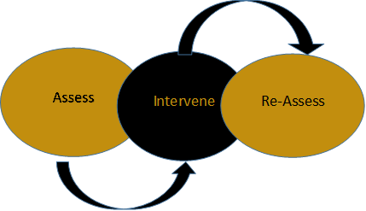
PFW Version of PLAIR Model

Slide 15
Working to develop Program Outcomes and Map to Courses
https://www.pfw.edu/offices/assessment/reports/pdf/PPOL-ASMT-RPT-2017-18.pdf
Divide in groups and map one outcome (goal) using the curriculum map in the workbook

Slide 16
Identifying existing Assessment Points
Assignments in core courses
Required out of class or experiential learning
Internships/Externships
Capstone Project

Slide 17
Determining Expected Learning Level
Use your Map to determine expected level of learning as students progress through the program to determine how you might measure student learning.
Use 3.2 to record when learning occurs, what level is expected, and how you will measure
Use 3.3 to identify potential metrics for the level of learning expected.

