Slide 1
Welcome to the
Fort Wayne Teaching &
Learning Conference
session on
The Course Syllabus:
Does Layout Affect Students Grades?
With Daniel Boylan, Ph.D.

Slide 2
Introduction
Innovative Education: Can syllabus organization impact student grades in a business class?
Background
Phenomenon
Assumptions / Limitations
Literature Review
Null and Alternative Hypotheses
Methodology
Findings
Conclusions
Education Industry Significance
Future Research

Slide 3
Introduction - Background
Chapter 1
Importance of the Syllabus:
Syllabus is the most important classroom document:
Many students work out their own personal expectations for themselves and create an outline of all their classes once they receive their syllabus.
A syllabus includes all the information about a class including due dates and grade criteria.
A syllabus can have an effect on the outcome of student grades.
Students do not want to struggle to find information

Slide 4
Introduction - Background
Chapter 1
Importance of the Syllabus:
There is an expectation gap between student and syllabus
Make the Syllabus important to the student:
Foster use of a “paper” syllabus
Use of a digital syllabus causes trouble
Memory is weaker
Assignments often are discovered by the due date
Students tend to skim (and miss the details)

Slide 5
Introduction - Background
Chapter 1
Importance of the Syllabus:
Content is important to different users:
The Teacher
The University
The Student
The information is typically placed in the order of importance for the teacher.
It is often the result of getting a copy of a “previous” syllabus.
What if content is placed in this order:
The Student
The Teacher
The University

Slide 6
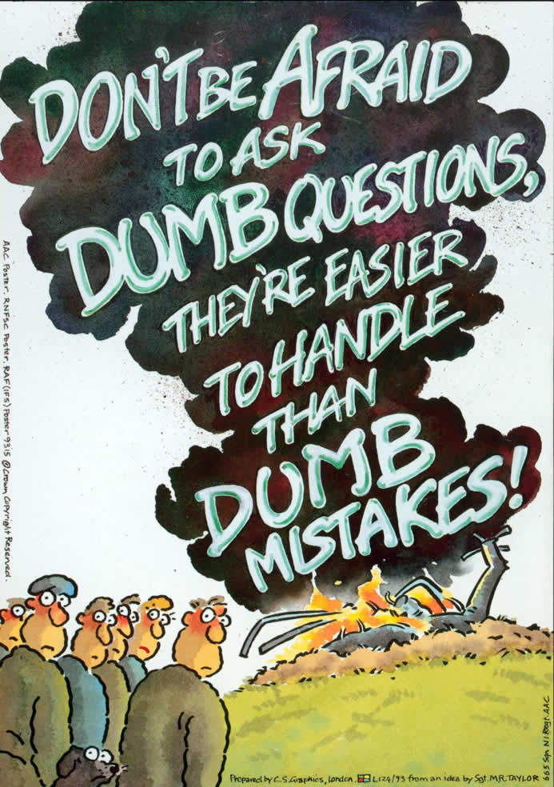
Introduction – Research question
Chapter 1
Research Question:
Can syllabus organization impact student grades in a business class?
Assumptions:
Students rely on the syllabus, but don’t necessarily read the syllabus
The order that items are presented in is important
Some sections of a syllabus are mandated by university policy

Slide 7
Limitations
Chapter 1
Lack of valid information on this specific topic - a few surveys on how syllabus impacts users
2. No surveys on syllabus layout
- specifically on how grades are impacted by organization.

Slide 8
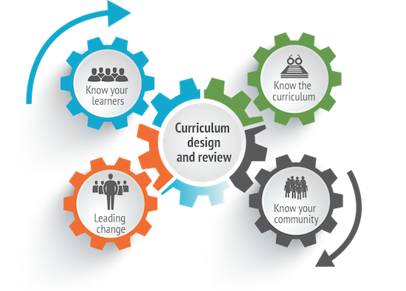
Literature Review
Chapter 2
Syllabus Review:
Universities don’t devote much training on syllabus development for faculty
The traditional syllabus is defined as a document that is provided by a professor to students which focuses on the most important course information.
Most importantly, it provides an outline of when assignments are due, what is expected of the student, legal information, and grade calculations.
3. Syllabi are generally treated as representation of course content and class rules.

Slide 9
Literature Review
Chapter 2
Syllabus Review:
The syllabus is a very important document
The syllabus is important to a university because it acts as a contract between students and their professors.
The syllabus is important to a student as it provides guidance for the course over the semester.
A syllabus sets the class tone - professors use the first day of class as an opportunity to review the entire syllabus for new students.

Slide 10
Methodology
Chapter 3
Procedure:
Student Academic Support Services organized a group of interested athletes.
Hosted one-day workshop
Students described their concerns on the syllabus
Students were given several copies of the syllabus to “cut up” and rearrange in the order they preferred

Slide 11
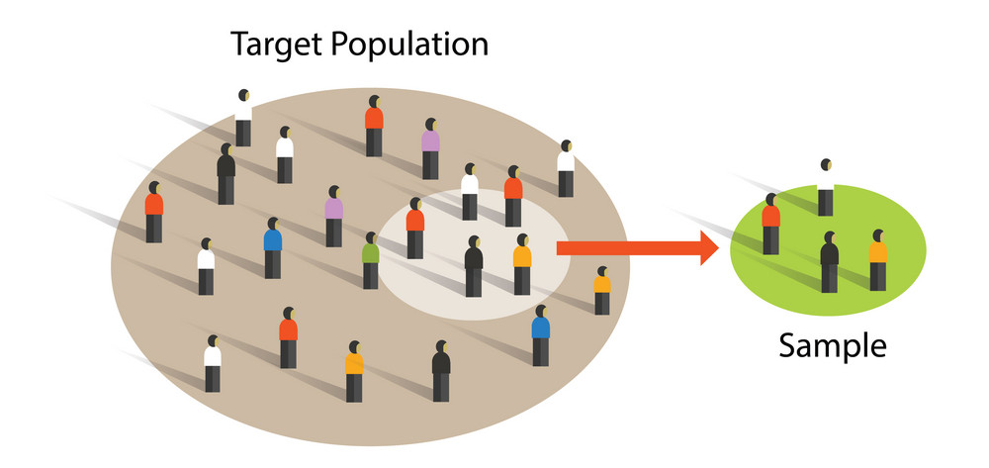
Methodology
Chapter 3
Sample Size:

Slide 12
Methodology
Chapter 3
Syllabus Before Changes:

Slide 13
methodology
Chapter 3
Syllabus After Changes:

Slide 14
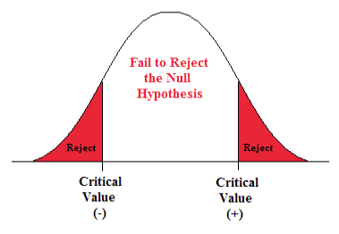
Null and alternative hypothesis
Chapter 3
The Null Hypothesis (H₀) is:
Where MC (mean with changes) is the same as MN (mean without changes).
H₀ where MC is the same as MN
H₀: MC₁ = MN₂
The Alternative Hypothesis (H_{a}) is:
Where MC (mean with changes) is greater than MN (mean without changes).
H_{a} where MC is greater than MN
H_{a}: MT₁ = MN₂

Slide 15
Findings – Grade Changes
Chapter 4
Pre-Changes vs. Post Changes:
“Reject” Null Hypothesis
Reminder: H₀: MC₁ = MN₂

Slide 16
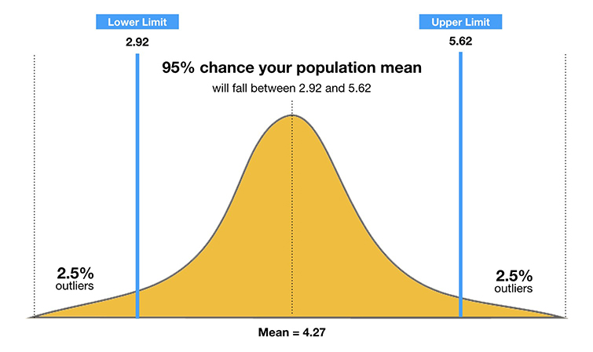
Findings – Grade Changes
Chapter 4
95% Confidence Intervals Changes:

Slide 17
Conclusions - overall
Chapter 5
Overall,
The general conclusion for this research is educators should organize a syllabus based on what students need to know, want to know, and then what the school needs to disclose.
Students need to know: course name, meeting time, professor, and location to name a few.
Students want to know: grading criteria, office policy, email policy, homework and test dates.
Items the university needs to disclose: items such as legal disclaimers, disability policy, plagiarism, and the instructor’s right to change the syllabus.

Slide 18
Study significance
Chapter 5
Education Industry Significance:
The syllabus is an extremely important document for the classroom.
Its usefulness is not only aimed at meeting department, college or university purposes but can be used to empower students.
The more widespread and user focused a syllabus can be, will result in students that are more engaged and focused on their objective of classroom success.

Slide 19
Study significance
Chapter 5
Other Syllabus Suggestions:
Use a semester theme
Have a complete syllabus with details
Use class points (I suggest 1,000 so math is easy)
Use “highlights” and “links”

Slide 20
Study significance
Chapter 5
Other Syllabus Suggestions:
Use pictures to draw attention

Slide 21
Study significance
Chapter 5
Other Syllabus Suggestions:
Use pictures to draw attention

Slide 22
Study significance
Chapter 5
Other Syllabus Suggestions:
Force students to hand calculate their grade:
It is not the teachers job to prove a score
It is a students job to understand their score.

Slide 23
Future Research
Chapter 5
Possible Topics Include:
Doing grade comparisons by academic year and gender
A comparison between adding statements on university services such as “career services” and “writing centers” to see if they experience increased student use.
Looking into other focus groups to see if they have different opinions on the layout.
Looking at if a university has a syllabus building workshop that helps educators in the creation of their syllabus, and if that aides student satisfaction.

Slide 24
acknowledgments
Sample references
Curtis, D. A., & Moore, K. (2018). The first day of class: Starting with an activity or syllabus? North American Journal of Psychology, 20(3), 653-669.
Guenther, R. K. (2012). Does the processing fluency of a syllabus affect the forecasted grade and course difficulty?. Psychological Reports, 110(3), 946-954. doi:10.2466/01.11.28.PR0.110.3.946-954.
Harrington, C., & Thomas, M. (2018). Designing a motivational syllabus: Creating a learning path for student engagement. Stylus Publishing, LLC.
Høgdal, C., Rasche, A., Schoeneborn, D., & Scotti, L. (2019). Exploring student perceptions of the hidden curriculum in responsible management education. Journal of Business Ethics, 1-21. doi:http://dx.doi.org/10.1007/s10551-019-04221-9

