Slide 1
Increasing Student Engagement with Challenge-based Learning—Hackathons
Lucy L. La Hurreau,
Kris Roberts,
Dr. Darrel J. Kesler
For fort Wayne 2020 teaching conference
Ivy Tech © 2020

Slide 2
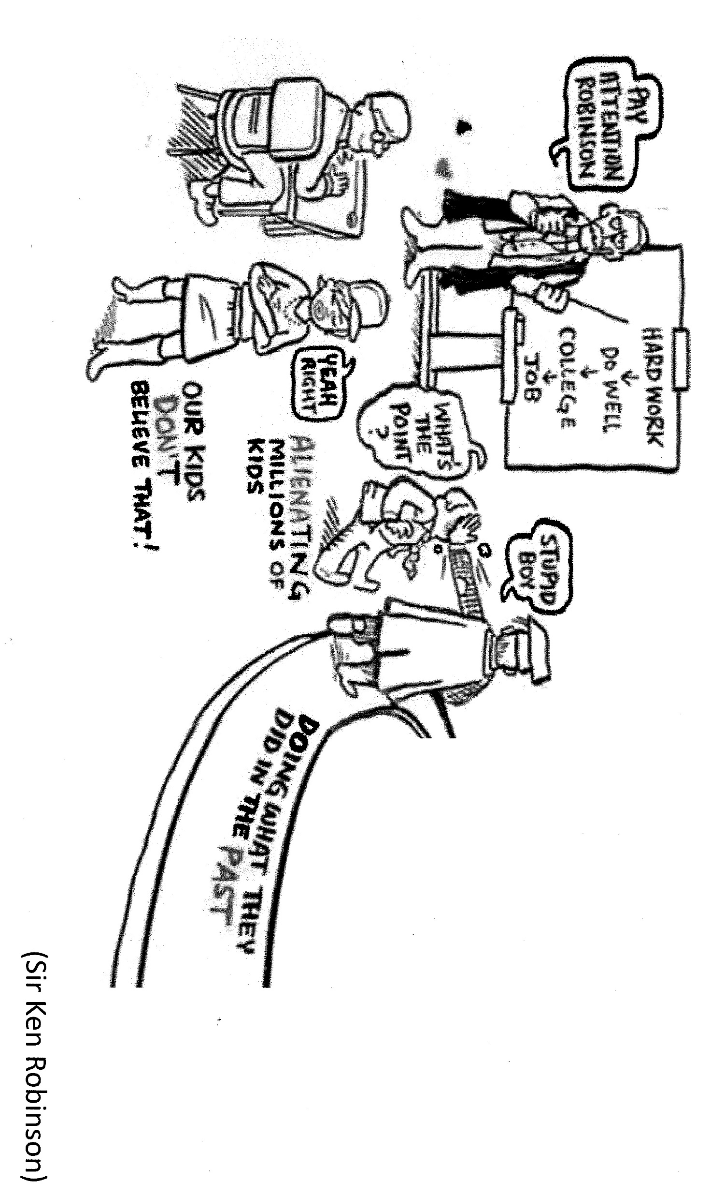
Notes:
Let’s talk. How many of you remember sitting in class. Half awake, listening to our teachers drone…on and on and on and on….Show of hands….
How many of us remember that if we step out of the box, questioned the way in which we were taught or what we were taught we were shot down? … show of hands …
How many remember Charles Schultz’s Charlie Brown scene where Peppermint Patty was in her seat with her head back and the only sound in the air was “mar mar mar mar mar mar mar mar?”
No matter what the research from the seventies said about placing your listeners in a coma because they learn better, no matter that there was a time where teaching was to lecture, then memorize, memorize and then memorize. And then, whatever homework the students would have would have them regurgitate the knowledge imparted to them by the “wiser” teacher, we now know…they were wrong.
HOWEVER …

Slide 3
 | Reflective v. | Intuitive v | Verbal v | Global v
Statistic * | Active | Sensing | Visual | Sequential
Mean | 60% | 65% | 78% | 60%
S.D. | 9 | 11 | 12 | 11
Range | 35-85 | 40-86 | 39-94 | 35-85
Notes:
So…here I am. I’m going to lecture AT you for a few minutes.
According to many of the teaching manuals there are eight basic styles of learning, of which we all learn differently with each subject. While we might find that we prefer to learn as a physical learner, we can also be a global learner. I’m about to throw out some terms in a few minutes and I want to make sure that you understand where we are.
Visual (spatial):You prefer using pictures, images, and spatial understanding.
Aural (auditory-musical): You prefer using sound and music.
Verbal (linguistic): You prefer using words, both in speech and writing.
Physical (kinesthetic): You prefer using your body, hands and sense of touch.
Reflective learning involves students thinking about what they have read, done, or learned, relating the lesson at hand to their own lives and making meaning out of the material.
Intuitive learners prefer to take in information that is abstract, original, and oriented towards theory. They look at the big picture and try to grasp overall patterns. They like discovering possibilities and relationships and working with ideas.
Global learning is a critical analysis of and an engagement with complex, interdependent global systems and legacies (such as natural, physical, social, cultural, economic, and political) and they are the ones who see the bigger picture. They just suddenly get it.
Sequential learners tend to gain understanding in linear steps, with each step following logically from the previous one. Sequential learners tend to follow logical stepwise paths in finding solutions.
However, in our traditional teaching styles, we expect the student to take in the information and then regurgitate it on demand.
As you can see from the table, there are a great many differences in learning style.
Active learners are 60 % of the population 40% of the population are the reflective type of student.
Sensing Learners are 65% while 35% of the population are Intuitive
Visual Learners are 78% and 22% of the population are Verbal Learners
Sequential Learners are 60% and the global learner comes in at a whopping 40%.
And while the learning style is “an individual’s consistent way of perceiving, processing, understanding, and retaining new information.”
They are not evenly distributed among students.
The following is based on a meta-study of 29 samples using the Felder and Spurlin methodology.
Variation is huge; however, there’s a greater preference (particularly among students in technology-based disciplines) towards sensing (tactile, hands-on) and visual learning.
This radically differs from the teaching style of traditional pedagogy.
…and not everyone agrees with these numbers or these theories. In fact, the American Psychiatric Association disagrees that there is any such thing as learning styles.

Slide 4
In fact, the American Psychiatric Association disagrees that there is any such thing as learning styles
https://www.psychologicalscience.org/journals/pspi/PSPI_9_3.pdf

Slide 5
This Photo by Unknown Author is licensed under CC BY-SA-NC
Notes:
If we look at those learning styles and we look at attention spans, it looks really weird, because, no matter our learning styles, a few things show up. Microsoft says that when we surf, we are staying about 8 seconds each website. If we don’t find what we want in those first 8 seconds….Bye Bye…we gone. Ted Talks limit their talks to 18 minutes because their research shows that all we have for an attention span.
So, if we look at a lecture of 50 minutes without breaks, our attention span lasted about 10 – 15 minutes.
In a traditional 4-year school that has a class that meets 3 times a week for an hour that lecture is 110 minutes, at about 37 minutes of lecture per day. You lost the student the first 15 minutes every class. And if you consider the idea, that some of our classes are 4-hour contact time classes, Well…While this is not scientifically proven, we can all agree that we don’t really have the attention span for the 4 hour class room.
Some of the suggested ideas that we can use are
Laboratory:
well-planned experiments typically containing step-by-step guides leading the students through each experiment,
students conduct the guides individually or teams, regurgitate the results, and prepare a laboratory report
However what we are doing right now, at the best is, and this is arguably, fulfilling ABET student outcome requirement (b) “an ability to design and
conduct experiment, as well as analyze and interpret data.”
Bradbury, N.A. 2016. Attention span during lectures: 8 seconds, 10 minutes, or more? Adv. Psysiol. Educ. 40:509-513
Carroll, C. 2013. Competition based learning in the classroom. 120th ASEE Ann. Conf. & Exposition.

Slide 6
Notes:
And as you can see, we are not going to be able to continue with our current way to teach. We are going to have to do other things. Our students that are under 30 were taught their ABCs in front of Sesame Street. Hopping and play and dancing and singing. Our students, you and me included, have broken our own attention span due to the Internet . And if you look at what I’ve got up here, we are going to have to think about this differently. Our skills are going to need to be different. What, in my parents’ time was prime jobs, as you can see on the chart, are no longer there. We are in need of the higher cognitive skills, the higher social and emotive skills, and the technology.

Slide 7
Notes:
According the McKinsey Quarterly, “As workers interact with ever-smarter machines, the demand for soft skills is beginning to surge. Feb. 4, 2020” and with those skills needs, as the current Prime Minister of India, Narendra Modi, has stated “Innovation no longer remains a choice but has become an imperative.”

Slide 8
Notes:
So, as I said, we can’t just continue in this way. Our students are going into the future as innovators not just workers. As more and more of the products coming from industry are not just team efforts from within the industry but they are open source .
Let’s talk about a different pedagogy than the traditional method. Let’s talk about project-based learning.
Project based learning student-centered pedagogy in which the students learn through the experience of solving an open-ended problem. They are ill defined: addressing a complex problem with minimal assignor input; there are multiple solutions; problem requires judgment, planning, the use of strategies, and the implementation of previously learned skills

Slide 9
Intra…, multi…, inter… trans…disciplinary
Intradisciplinary
Multidisciplinary
Interdisciplinary
Transdisciplinary
This Photo by Unknown Author is licensed under CC BY-NC-ND
Notes:
Education!!
Radical novelty in education frequently generates resistance; however, radical novelty would not be necessary if traditional pedagogy was consistently effective.
Are we just satisfying requirements, seeking good teaching evaluations, or do we want to graduates to be prepared to establish careers that are fulfilling and are prepared for lifelong workforce change?
Hackathons are one of multiple informal challenge-based learning platforms.
They tap into our inquisitive and competitive natures and advance multiple workforce skills.
They are engaging and empowering and inspire individuals to pursue careers in math, science, and technical fields.
The spirt of fun and excitement is infectious and the sense of satisfaction that comes from achievement is palpable.
Concern:
Some have concern that as extracurricular activities they may negatively impact academic performance.
This appears to be unwarranted. Hackathon participants have small (2-5%), but consistently higher GPA’s than non-participating students.
So, what are we looking at? We see that traditionally we have worked with the Intradisciplinary, and that is working within a single discipline. Unfortunately, this has led to organizational siloing. We’ve worked with Multidisciplinary drawing knowledge from different disciplines by working in juxtaposition; species mosaicism*. We’ve worked with Interdisciplinary: integrating knowledge and methods from different disciplines; sterile hybridism*. Now, let’s consider Transdisciplinary: systemic integration of knowledge; hybrid speciation*.
More than 50% of the hackathons are recurring events, indicating that they are a reliable tool for sustained innovation.

Slide 10
Group Projects vs. Hackathons
Notes:
And I can hear all of you asking that one question … isn’t this just a group project on speed? Yes. However, if you look at the definition of group project you will find, “A project that requires you to work with your peers - intended to simulate the 'real world' where you work with other people on a day-to-day basis - it does this rather well, because like the 'real world’ the bulk of the group will be freeloading off of the work of the more responsible individuals (usually you).”
Hackathons are also Competition—based learning: scaled down version of a problem teams of students may encounter in their career with respect to other groups. But But let’s look at it. What are Hackathons?
Hackathon is a portmanteau of “hack” and “marathon.”
Hack: exploratory programming or creative problem-solving, designing, prototyping, and tackling of a challenge;
not hacking (breaking) into a computer.
The idea of a hackathon or creating a “hack” is quite literally a playful approach to improving or creating something.
Today we use the term to mean a competition among software and/or hardware developers to build a spectacular to provide a hard-hitting solution to an existing problem.
beyond conventions a competition empowers minds to bring forth unfathomable talent and hidden innovation from deep within the participant.

Slide 11
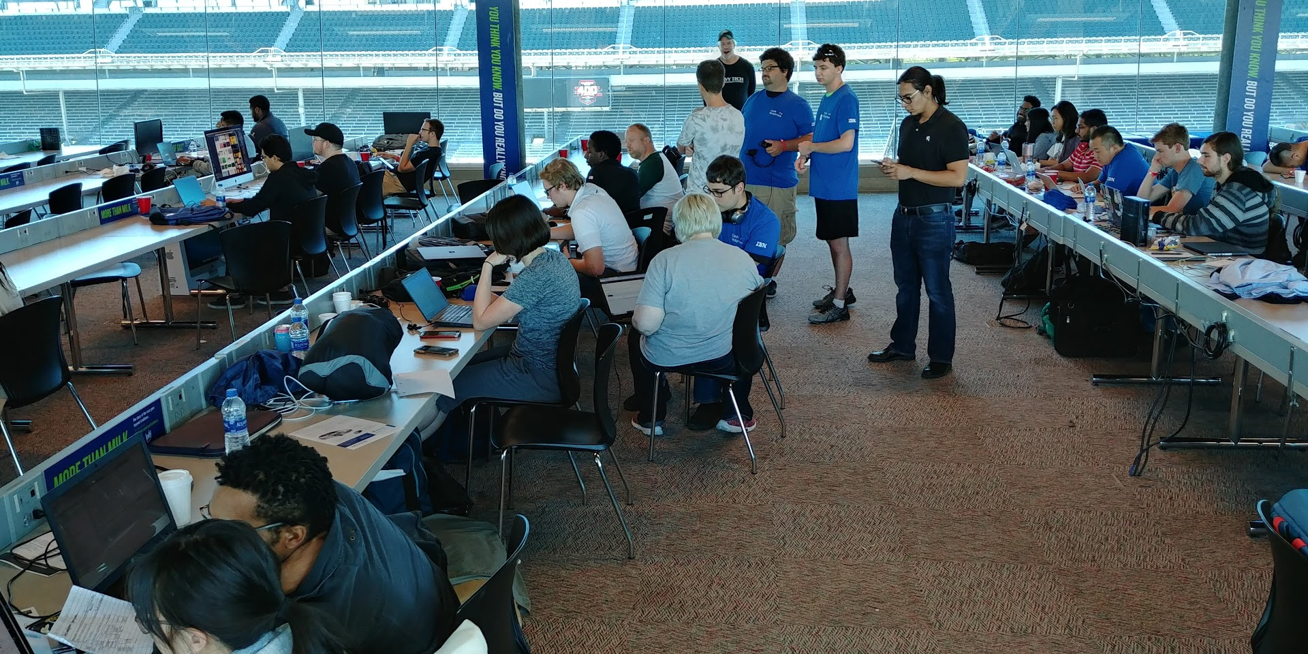
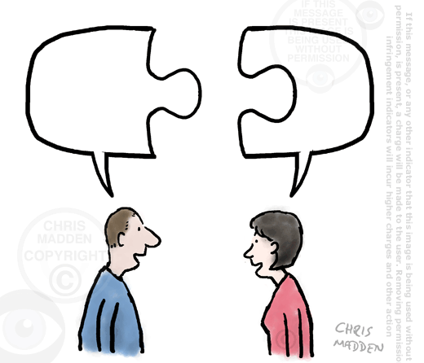
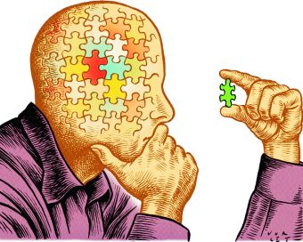
Collaboration
Communication
Creativity
Critical Thinking
This Photo by Unknown Author is licensed under CC BY-SA
Notes:
So, let’s get down to brass tack. Because we’ve bantered that word about a bit. A Hackathon is an event, typically lasting several days, in which many people meet to engage in collaborative computer programming and work on other technological issues.
What it is
This is where computer professionals come together to work on problems. Whether those problems be cyber security, web sites, software development, or networking issues. They occur over a period of twenty-four to forty-eight hours of non-stop work with a team who barely know each other. They learn to work with new technology, throw together new code, and live on food and caffeine. Literally bringing ideas and dreams into reality.
Advantages?
Networking
Met business leaders
Military
Technology experts
Portfolio
These hackathons can be added to the resume
Challenge
A hackathon challenges your skills and your knowledge.
Confidence
Be surprised by how many people think they haven’t anything to add and really do
Teamwork
They’ve learned to work together and get along in stressful situations
Communication skills
This forces open communications and makes you think about what’s going on and how you and your teammates are doing. You might be the one that says, let’s go take a walk – or the one who needs it – but with that practice, you’ll understand how your fellow teammates feel.

Slide 12
The Timeline of a Hackathon

Slide 13
Internal – Opensource - Crowdhackathon
Facebook’s Internal Hackathons
Includes new utilities: “Like” Button, “Chat” Button, and “Timeline” of Facebook were created during company-internal hackathons.
Million-dollar Startups via Internal Hackathons
Docracy: app that allows businesses to locate legal documents safely.
Appetas: website builder for restaurants.
Manufacturing Industry (Internal or External)
Enabling Industrial IoT
Crowdhackathon Enabling Industry 4.0
Societal Issues (Opensource)
Smart City Hackathon: https://scos.splashthat.com/
Urban Community and Social Cohesion Hackathon: http://1001.impacthub.net/

Slide 14
Novel Hackathons
Epilepsy Hackathon
To “bring together developers, designers, and digital experts, along with healthcare providers and patients to imagine new ways of applying digital technologies that can make a real difference for the epilepsy community.”
https://www.ucb.com/stories-media/story-videos/epilepsy-hackathon
IIoT Hackathon
To discover the potential of the latest technologies and how they can be fully exploited.
https://www.industryofthingsworld.com/hackathon
Microsoft Azure FarmBeats
Created as a result of an internal Microsoft Hackathon
Enables building data-driven digital agriculture solutions.
https://azuremarketplace.microsoft.com/en-us/marketplace/apps/microsoftfarmbeats.microsoft_farmbeats?tab=Overview
ATT First Net technologies that help with the emergency services needs.
https://www.verizon.com/business/learn/public-safety/first-responders-5g-response-ready/?CMP=KNC_SMB_AWR_NA_VB_202001_GGL_Public-Saf_000002_GenMar-1111_1111_1111_1111&dcmID=1&utm_medium=KNC&utm_source=GGL&utm_campaign=Public-Safety-SEM-Google&utm_content=AWR&utm_term=GenMar&gclid=EAIaIQobChMIqrOLh77e5wIVhZ-zCh1tdgk1EAAYASAAEgL0IvD_BwE&gclsrc=aw.ds

Slide 15
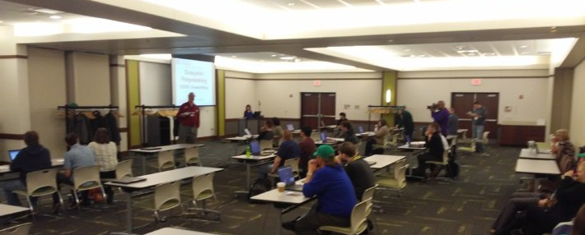
CCDC 2019
Notes:
Collegiate Cyber Defense Competition 2019.
According to the CCDC site (https://www.nationalccdc.org/index.php/competition/about-ccdc/mission)
The mission of the Collegiate Cyber Defense Competition (CCDC) system is to provide institutions with an information assurance or computer security curriculum a controlled, competitive environment to assess their student's depth of understanding and operational competency in managing the challenges inherent in protecting a corporate network infrastructure and business information systems.
The Events are designed to:
Build a meaningful mechanism by which institutions of higher education may evaluate their programs
Provide an educational venue in which students are able to apply the theory and practical skills they have learned in their course work
Foster a spirit of teamwork, ethical behavior, and effective communication both within and across teams
Create interest and awareness among participating institutions and students

Slide 16
Ivy Tech IT Challenge 2019
Notes:
The Ivy Tech IT Challenge 2019 (https://www.ivytech.edu/itchallenge/ )
This challenge is geared toward all the programs statewide for the Ivy Tech Community College computer and Visual Communications student
The Competition Areas are:
Network infrastructure
IT support
Cyber security/information assurance
Server administration
Database management
Software development
Computer science
Visual communications
For each area, the student is challenged to solve a design problem, software need, data mining and administration., hardware assembly and software installation, networking administration and configuration tasks based upon the professional certification tasks, for separate areas of cyber security tasks, and the creation of an advertising layout for a supplied common commercial product.
Ivy Tech Fort Wayne team garnered 4 1st places and 3 2nd places at this event.

Slide 17
CCSC - Midwest 2019
Notes:
Consortium for Computing Sciences in Colleges, Midwest 2019
This is a multi-discipline conference with a hackathon that provides the students to participate within a team sitting. The teams are given a task with a specific parameter and time setting. They are required to only use C+ or java.
According to the CCSC – Midwest site, https://www.ccsc.org/midwest/student-programming-contest
“Each team consists of at most three student contestants from the same institution. Teams of fewer than three contestants are allowed but discouraged as they usually are not competitive.
A student contestant must be enrolled in an undergraduate degree program at the sponsoring institution with at least a half-time load. This rule is not to be construed as disqualifying co-op students, exchange students, or students serving internships.”
This last fall, Ivy Tech was one of only two-year colleges of the participating teams of 26, that were from two-year schools. The rest of the participants were from four-year schools. The Ivy Tech Team won 3rd in their category and 1st in the two-year category.
ITCC Fort Wayne will be hosting the event on the last Friday and Saturday of September 2020 with the competition being on Saturday.

Slide 18
FirstNet Hackathon Indy 2019
Notes:
Student participated in the FirstNet hackathon in Indianapolis and developed an app for assisting first responders in the field. FirstNet is the only communication tool dedicated to public safety, including law enforcement, fire, and EMS personnel. It provides reliable communication services and highly secure data connections. ITCC Team representing eight regions of ITCC, won 1st in their event and 3rd overall. The application that the team presented has gone into the development phase for another event that will be taking place later in the year.
https://www.evensi.us/firstnet-hackathon-road-5g-4750-west-16th-street-south-entrance-gate-2/324060220

Slide 19
HackIn 2019
Notes:
This event was supported by Indiana Innovation Institute (IN3) and Booz Allen Hamilton.
And was to innovate and demonstrate reverse engineering techniques. There were many of the four-year colleges that participated with four separate teams from 5 regions of ITCC participating. This was an exciting time for the students as they got to mingle with many of the professionals and learned what they were going to need in their profession. In this case, the teams were to reverse engineer hardware and firmware. The goal was to determine what a device, found on the business property, was, and what it’s was to do. With this, the students discovered their skills and ability to respond to outside threats.

Slide 20
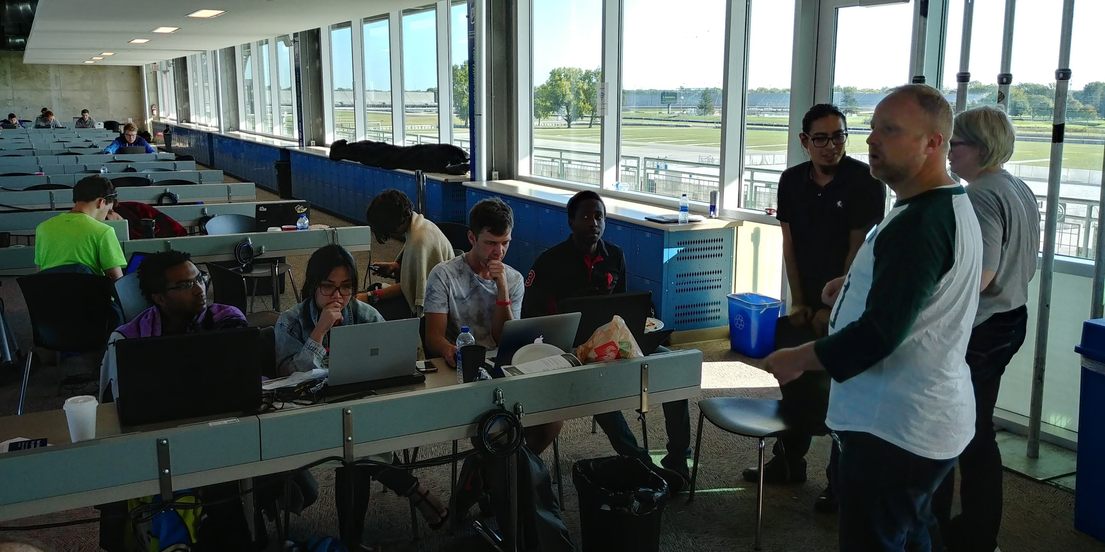
Hour 5
What was your weekend like??
Hour 22
Notes:
So, what is it I want you to know here? I want you to work differently. Get our student to work with their innately different learning styles as well as with the innately diveres community styles.
Hypothosis event based learning aids with student retention and completion.
Question is: how do we prove or disprove the hypothesis?

Slide 21
This Photo by Unknown Author is licensed under CC BY-NC-ND
Notes:
I have asked my students one question: “
“If you were to leave Ivy Tech today what would be the most memorable aspect(s) of your Ivy Tech Education (one or more).”
Some of the students have told me that when they leave Ivy Tech, their most sustaining memory are those events. Because this is where they meet mentors, professionals, and where they discovered both what they knew and what they didn’t know. They discovered tools that gave them the confidence to go out into the real – world and jump into jobs they didn’t think they’d ever do. And they have made lifelong friends that they don’t think they will ever lose.
In conclusion. Over the next few years, we want to track our students who participate in the hackathons and other challenge based events to see how they are doing. Statistically, I need to talk to more than the fifteen that participated in the First Net Hackathon in Indy. And I want to track for a number of years. In the meantime, Let me ask you something. How would you hand the research and data collection?

Slide 22
Resources
Consortium for Computing Sciences in Colleges, Midwest 2019. https://www.ccsc.org/midwest/student-programming-contest
La Hurreau, Lucy. Ivy Tech Community College. CCSC – Midwest 2019 Photo
La Hurreau, Lucy. Ivy Tech Community College. CCDC 2019 Photo
La Hurreau, Lucy. Ivy Tech Community College. IT Challenge 2019 Photo
La Hurreau, Lucy. Ivy Tech Community College. HackIn 2019
La Hurreau, Lucy. Ivy Tech Community College. FirstNet Hackathon 2019
HackIn 2019. http://in3indiana.com/hackin2019/
Local Ivy Tech Students Place at AT&T First Net Hackathon. Ivy Tech New Release. October 1 2019. https://www.eaglecountryonline.com/news/local-news/local-ivy-tech-students-place-at-atandt-firstnet-hackathon/

Slide 23
Resources
Learning Styles. Felder, R.M. and J. Spurlin. 2005. Applications, reliability and validity of the Index of Learning Styles. Int. J. Engineering Education 21(1):103-112.
Bradbury, N.A. 2016. Attention span during lectures: 8 seconds, 10 minutes, or more? Adv. Psysiol. Educ. 40:509-513.
Carroll, C. 2013. Competition based learning in the classroom. 120th ASEE Ann. Conf. & Exposition.
What learning style do you prefer? Jonathan Gutow. University of Wisconsin. August 21, 2017. https://www.uwosh.edu/facstaff/gutow/general-study-hints-and-info/what-learning-style-do-you-prefer
Learning Styles: Concepts and Evidence. Harold Pashler, Mark McDaniel, Doug Rohrer, and Robret Bjork. Psychological Science in the Public Interest. Volume 9 #3. December 2008. https://www.psychologicalscience.org/journals/pspi/PSPI_9_3.pdf

Slide 24
Resources
Identifying Visual-Spatial and Auditory-Sequential Learners: A Validation Study. Linda Kreger Silverman, Ph.D. Gifted Development Center. 2020. https://www.gifteddevelopment.com/visual-spatial/identifying-visual-spatial-and-auditory-sequential-learners-validation-study
Soft Skills for a Hard World. McKinsey Quarterly Five Fifty. https://www.mckinsey.com/featured-insights/future-of-work/five-fifty-soft-skills-for-a-hard-world
Attention span during lectures: 8 seconds, 10 minutes, or more? Neil A. Bradbury. Chicago Medical School. 19 October 2016. https://journals.physiology.org/doi/pdf/10.1152/advan.00109.2016
What is Problem-Based Learning (PBL)? Lynn Bartels and James Beil. Southern Illinois University. https://www.siue.edu/facultycenter/services_resources/teaching/pbl.shtml

Slide 25
Project Based Example
In today’s world, we need to keep all our personal identity private. Any portion of our demographics can be used to access more and to lose our rights to financial aid, loans, or, in some cases, social assistance.
Funny though, isn’t it? That when we travel, we place on our bags a tag with our names, addresses, phone numbers, etc etc etc…and the tags are given to us free…by the Airport! Do we know who has access to our bags? So, your project today is to figure out how to take the luggage tag and turn it into something that will protect our privacy.
This Photo by Unknown Author is licensed under CC BY-NC-ND

