Slide 1
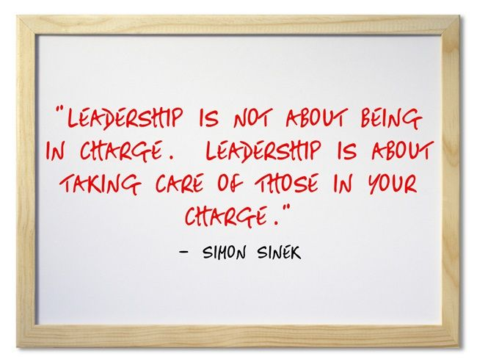
The Servant Professor: Embracing a student-focused culture in higher ed
Dr. Scott Liebhauser
Associate VP for Academic Affairs

Slide 2
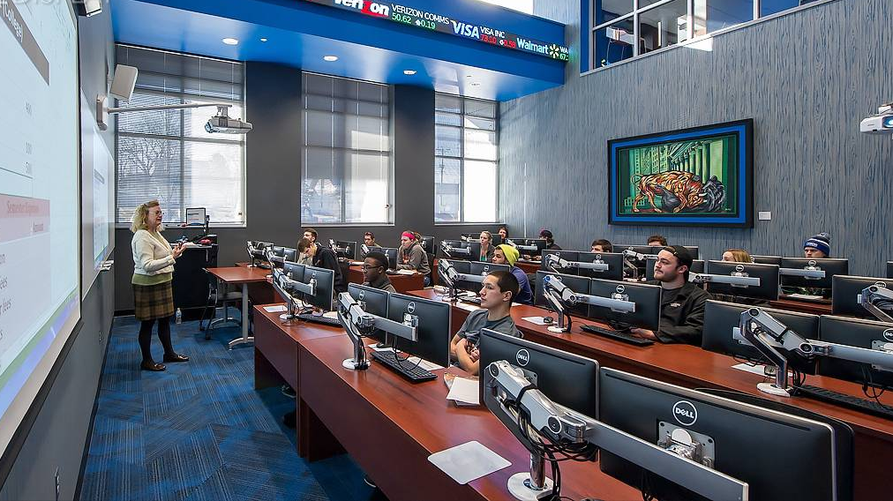
Why are we professors?

Slide 3
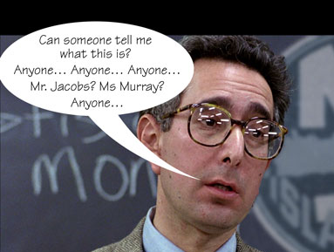
A very brief history of servant leadership
Plato, Sophocles, Xenophon, Cicero…
“Whoever wants to become great among you must be your servant…” -Jesus Christ
“The servant-leader is servant first… It begins with the natural feeling that one wants to serve, to serve first.” -Robert K. Greenleaf
At least 37 published academic models

Slide 4
the servant leader construct as a basis for pedagogy (& Andragogy)
It’s all Greek to me!
“paidos” = child
“andr” = adult
“agagos” = leader of

Slide 5
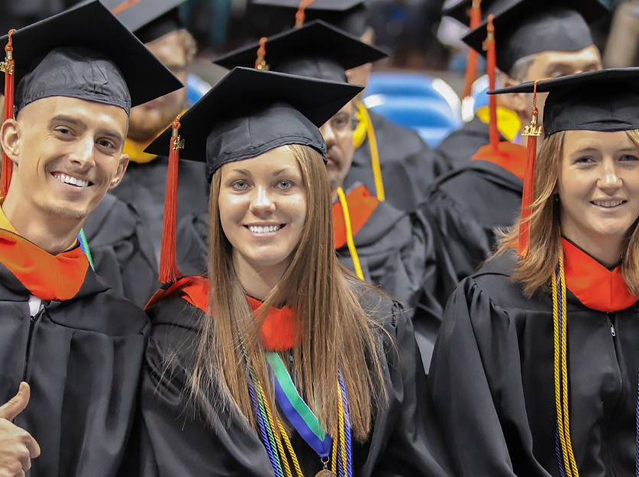
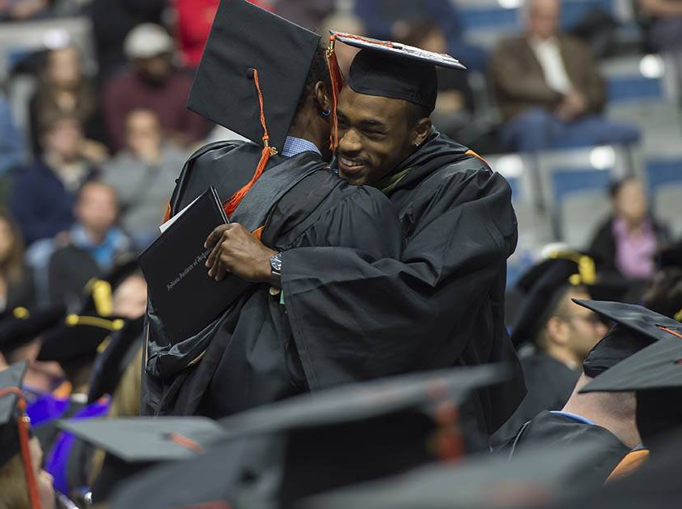
The value of a servant professor
Support for weaker students
Stability during a time of instability
Honest and empathetic feedback
Encouragement
Guidance toward ‘the next step’
Seeing each student as an individual
Providing a model of lifelong learning
Being “that one” that cared enough to…

Slide 6
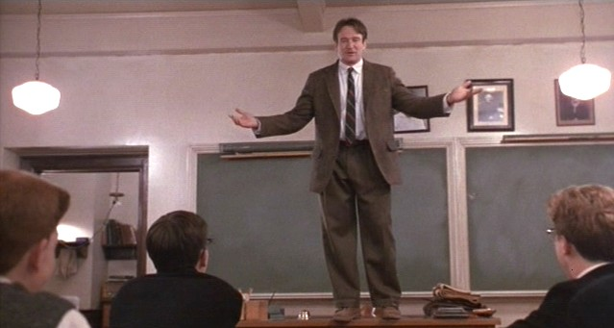
Which teacher or professor made the most positive impact on you?

Slide 8
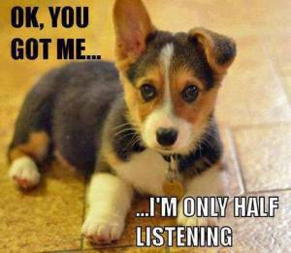
Are we Listening?
Do we take time to listen to (hear) our students?
Are we interested in knowing their “story”?
Do we see the individual or just a classroom full of “cookie cutter” students?

Slide 9
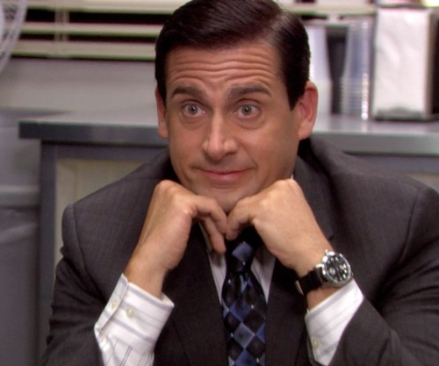
Empathy-Do we care?
What does empathy look like in the classroom?
But we’ve been burnt before!
How can we empathize with a failing student? (Accountability vs. Mercy)
Seeing a loved one when dealing with a challenging student.

Slide 10
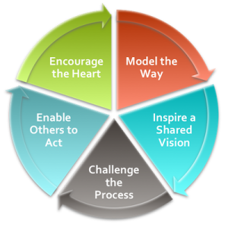
Integrating Kouzes and Posner’s leadership model into the classroom
http://www.leadershipchallenge.com/about-section-our-approach.aspx

Slide 11
Do we practice what we (profess) Preach?
We are being watched!
Speak well of colleagues and students
Emulate those we most highly revere
http://www.leadershipchallenge.com/about-section-our-approach.aspx

Slide 12
Are we just teaching stuff or leading our students to something greater?
Point them to something grander!
Lead them to serve others
Be passionate, it’s contagious!
http://www.leadershipchallenge.com/about-section-our-approach.aspx

Slide 13
transformational leadership
Create learning opps not landmines
Don’t be quick to pounce
Lead them to personal responsibility
http://www.leadershipchallenge.com/about-section-our-approach.aspx

Slide 14
How well do we know our students?
Each student has a unique story-find it!
Don’t quickly cast off unruly students, consider them your mission
Be there for them outside of the four walls
http://www.leadershipchallenge.com/about-section-our-approach.aspx

Slide 15
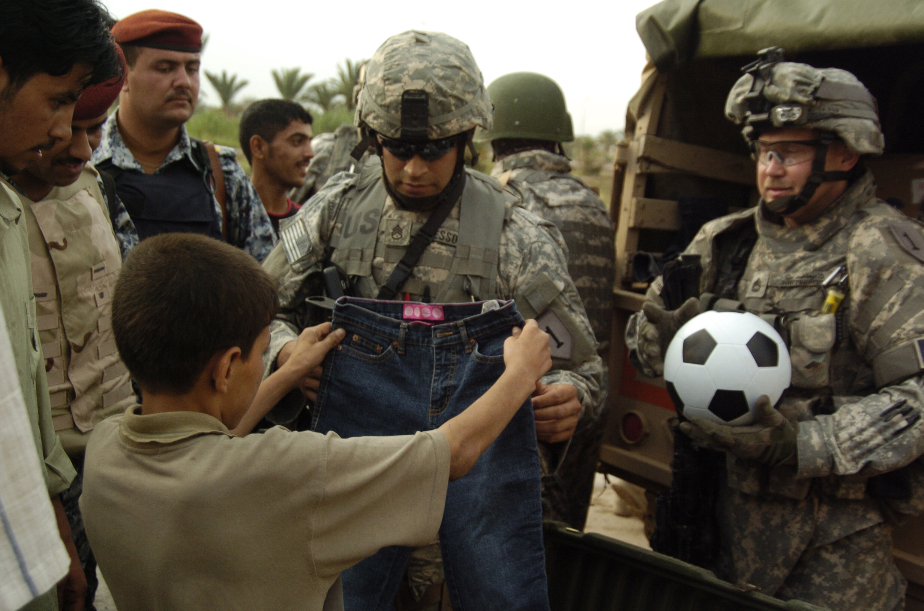
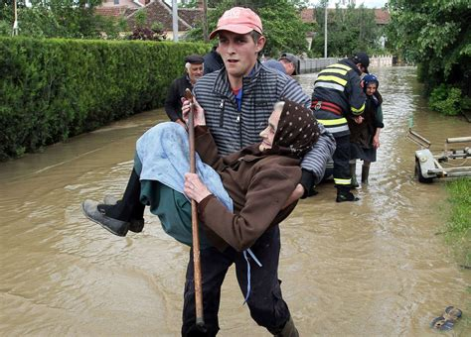
What is the goal of the servant professor?
Your Ideas?

Slide 16
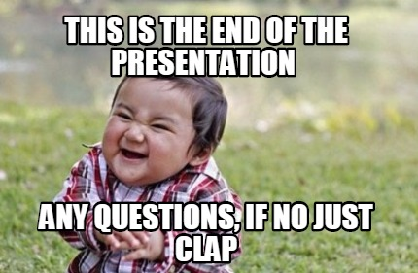
Contact Information:
Dr. Scott Liebhauser
260.422.5561 Ext. 3449
sdl01@indianatech.edu
"We must be silent before we can listen. We must listen before we can learn. We must learn before we can prepare. We must prepare before we can serve. We must serve before we can lead.“
-William Arthur Ward

