Slide 1
After creating a name plate, please share with a neighbor your earliest learning memory

Slide 2
Framing
Content
Application
Examples

Slide 4
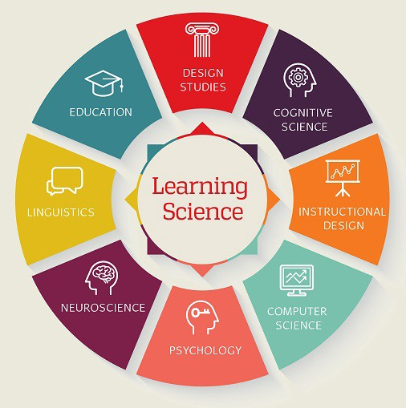
INTER-DISCIPLINARY
Research
Data
Practice
Learning science disciplines (McGraw-Hill, 2019)
Notes:
Research-based, data-informed praxis
https://www.mheducation.com/learning-science.html

Slide 5
Figure 4: Learning science video (Muller, 2017, March 2)
Notes:
Research-based, data-informed praxis
https://www.mheducation.com/learning-science.html

Slide 6
System 1 Thinking
Fast
Automatic
Emotional
Unconscious

Slide 7
System 2 Thinking
Slow
Effortful
Logical
Conscious

Slide 8
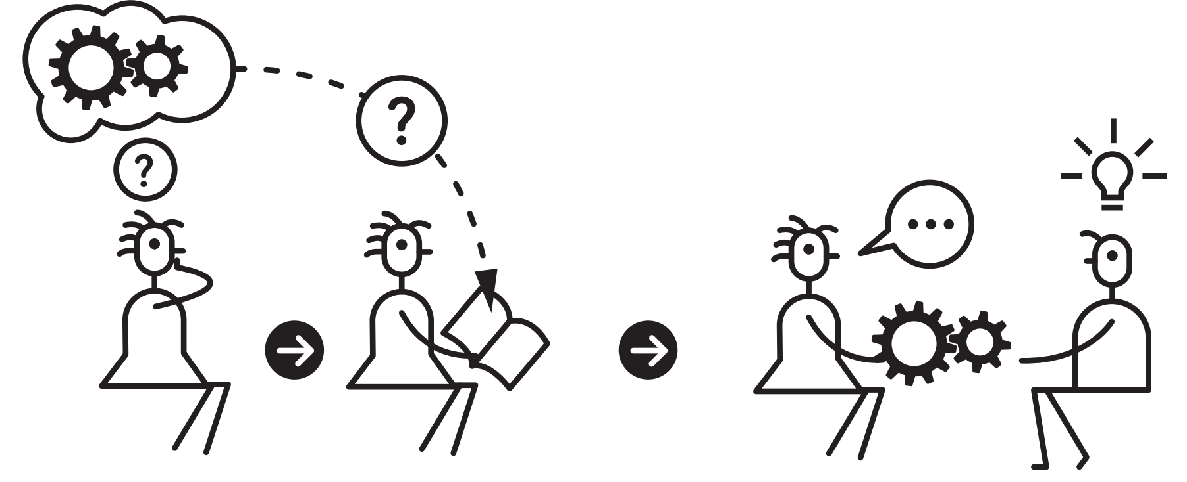
ELABORATION
Ask yourself questions while you are studying about how things work and why, and then CONNECT to class materials
(Sumeracki, n.d.)

Slide 9
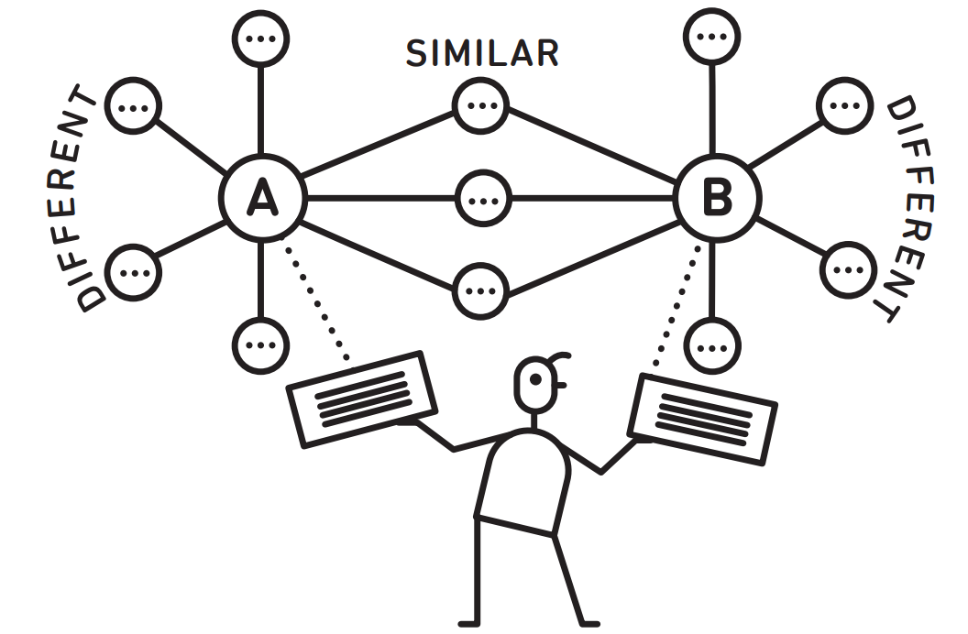
ELABORATION
CONNECT
two ideas by thinking of ways they are similar and different
(Sumeracki, n.d.)

Slide 10
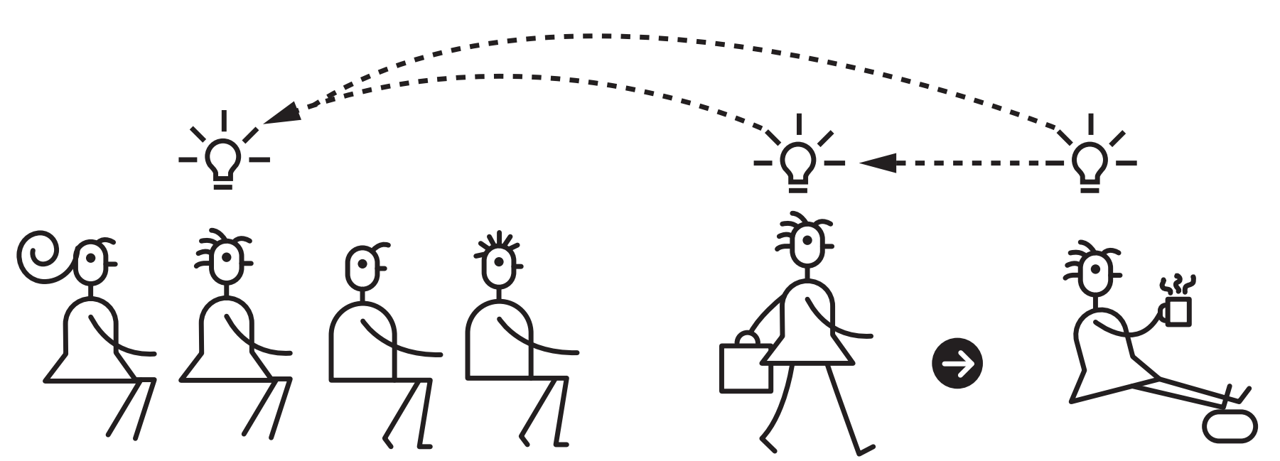
ELABORATION
Describe how the ideas you’re learning APPLY to your own experiences and memories
(Sumeracki, n.d.)

Slide 11
Voice
Purpose
Style
Audience

Slide 12
Tell someone sitting close to you about a time you were part of an audience...
Make that a part of your notes- you just Elaborated!

Slide 13
Let’s flip it a bit…relay, to a different person, a time you were in front of an audience…
Make that a part of your notes- you just Elaborated!

Slide 14
Tell someone sitting close to you about a time you remember doing something by “muscle memory”- using Gunn.

Slide 15
Now think about your courses…
What’s one lesson in which you could have students CONNECT content/skill to something they’ve already experienced?

Slide 16
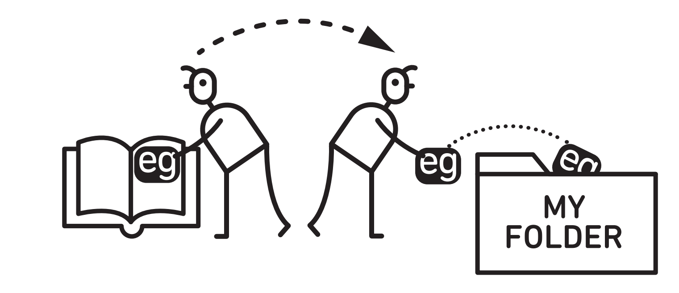
CONCRETE EXAMPLES
COLLECT examples your instructor has used and look in the course material for more examples.
(Sumeracki, n.d.)

Slide 17
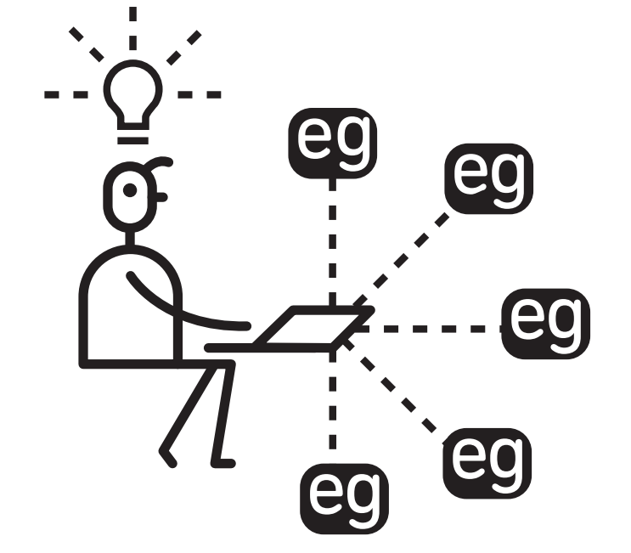
CONCRETE EXAMPLES
Make the LINK between the idea you are studying and each example, so that you understand how the example applies to the idea.
(Sumeracki, n.d.)

Slide 18
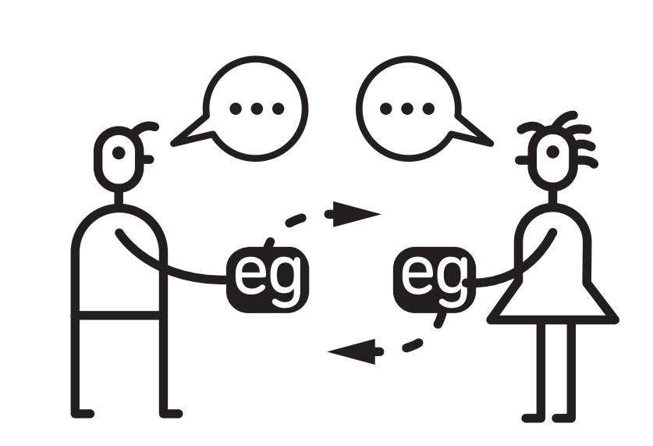
CONCRETE EXAMPLES
Share examples with friends, and EXPLAIN them to each other for added benefits.
(Sumeracki, n.d.)

Slide 19
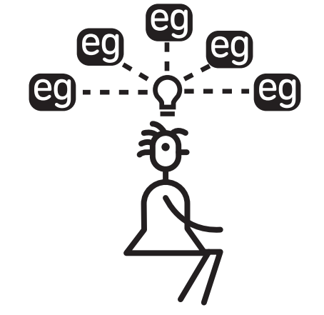
CONCRETE EXAMPLES
Ultimately, CREATING your own relevant examples will be the most helpful for learning.
(Sumeracki, n.d.)

Slide 20
Voice
Purpose
Style
Audience

Slide 21
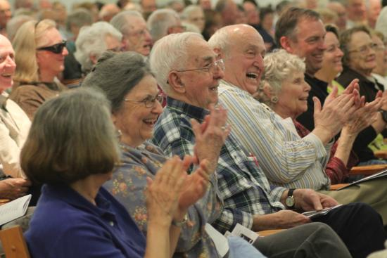
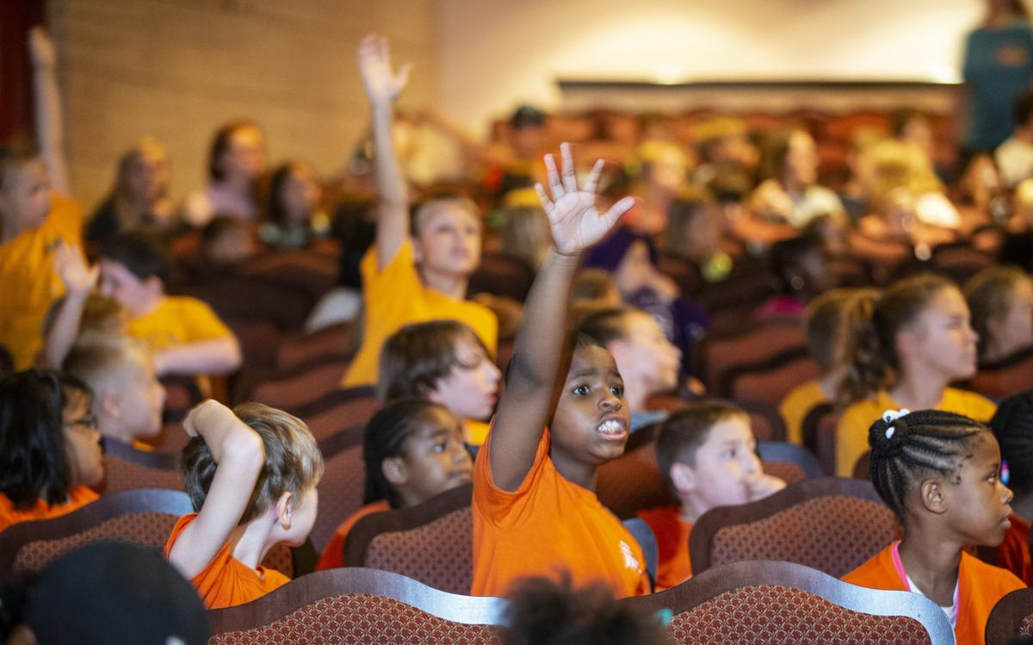
WHO IS YOUR AUDIENCE?

Slide 22
Create an Audience
Age
Gender
Education
Ethnic Background
Socio-Econ
Status
Occupation
Make that a part of your notes- you just created a Concrete Example!

Slide 23
Jot down an example of something you do that you suspect is the work of Drew.

Slide 24
Now think about your courses…
What’s one lesson in which you could have students CREATE a specific, concrete example?

Slide 25
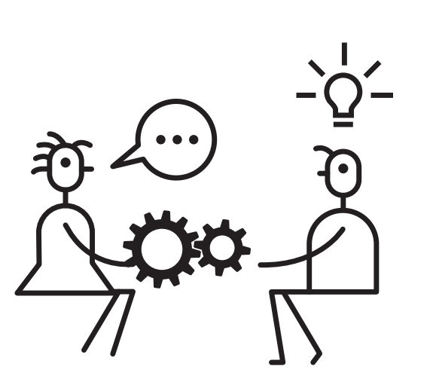
ELABORATION
CONCRETE EXAMPLES
(Sumeracki, n.d.)

Slide 26
References
Fraefel, U. (2014, November). Professionalization of pre-service teachers through university-school partnerships. Paper presented at WERA Focal Meeting, at Edinburgh. doi:10.13140/RG.2.1.1979.5925
Geerlings, L., & James Cook University. College of Arts, Society and Education. (2015). Cultural negotiations in transnational knowledge: Cases of clinical psychology from the Malay archipelago and beyond (Unpublished doctoral dissertation). James Cook University.
Hamzelou, J. (2017). Your autopilot mode is real - now we know how the brain does it. NewScientist, (issue 3149). Retrieved from https://www.newscientist.com/article/2151137-your-autopilot-mode-is-real-now-we-know-how-the-brain-does-it/
Immordino-Yang, M. (2016). Emotions, learning, and the brain : Exploring the educational implications of affective neuroscience (First ed., The norton series on the social neuroscience of education). New York: W.W. Norton & Company.
Kahneman, D. (2011). Thinking, fast and slow (1st ed.). New York: Farrar, Straus and Giroux.
McGraw-Hill. (2019). Learning Science. Retrieved from https://www.mheducation.com/learning-science.html ls pic
Muller, D. (2017, March 2). The science of thinking [Video File]. Retrieved from https://www.youtube.com/watch?v=UBVV8pch1dM
National Academies of Sciences, Engineering, and Medicine. (2018). How People Learn II: Learners, Contexts, and Cultures. Washington, DC: The National Academies Press. https://doi.org/10.17226/24783.
Sawyer, R. K. (2006). The Cambridge Handbook of the Learning Sciences. Cambridge: Cambridge University Press. Retrieved from http://search.ebscohost.com.tuproxy.palni.edu/login.aspx?direct=true&db=nlebk&AN=167882&site=ehost-live&scope=site
Sumeracki, M. (n.d.). The Learning Scientists. Retrieved from https://www.learningscientists.org/
Weinstein, Y., Sumeracki, M., & Caviglioli, O. (2018). Understanding how we learn: A visual guide. Milton: Routledge.
Notes:
Research-based, data-informed praxis
https://www.mheducation.com/learning-science.html

