Slide 1
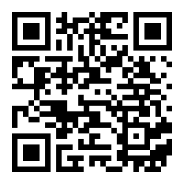
Use TACtivity, Technology, and Reflections to Engage Students and Enhance Learning
2020 Fort Wayne Teaching & Learning Conference
Dr. Yun Su, Indiana Tech

Slide 2
Semi-flipped Classroom
Mini-lectures (new concepts + examples)
Group work (worksheets provided; volunteers present solutions on board)
14-36 students
Weekly homework assignments
Biweekly in-class quizzes
3 exams + final exam
Extra-credit GeoGebra projects

Slide 3
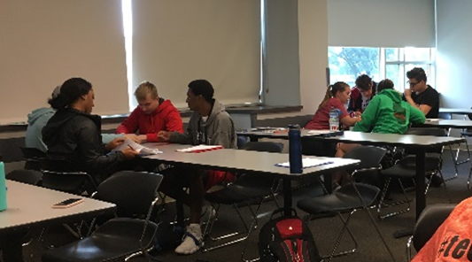
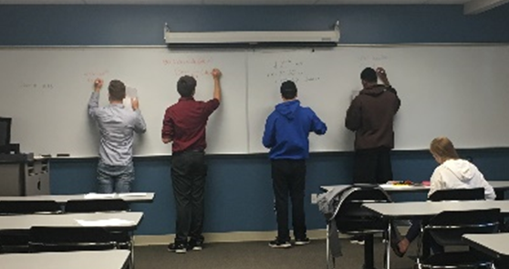
Group work

Slide 4
Techniques
Engaging with Students in Class
TACtivity
Kahoot Game (Exam review)
GeoGebra projects (Extra credits)
Bonding with Students
First-Day Questionnaire – understand the expectations
Exam Wrapper – help students improve through self-reflections

Slide 5
What is a TACTivity? A tactile activity that encourages collaboration and engagement.
Angie Hodge at MAA MathFest 2018
Tactile (movable cards)
Actively engages students
Can be used to help teach or to review a concept
Most are designed for groups of 2-4 students
Often self-checking
Very few directions needed

Slide 6
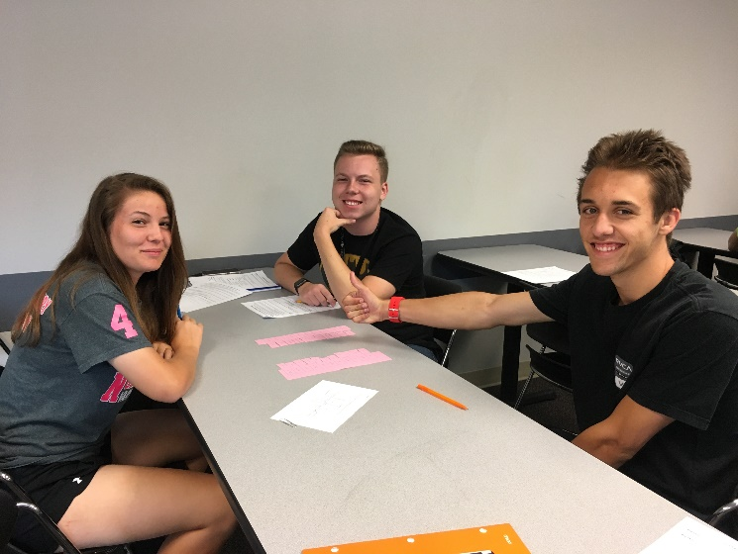
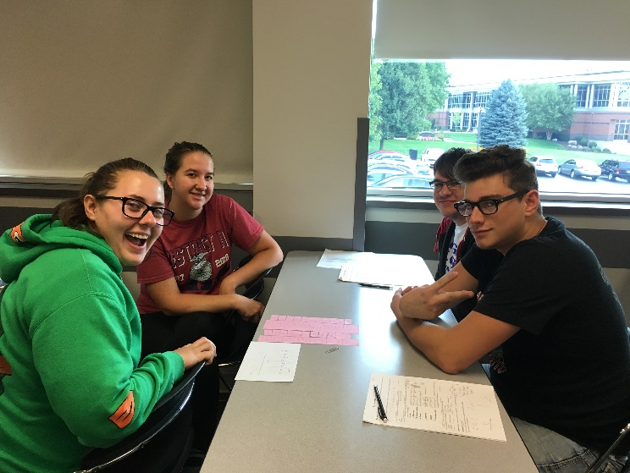

Slide 7
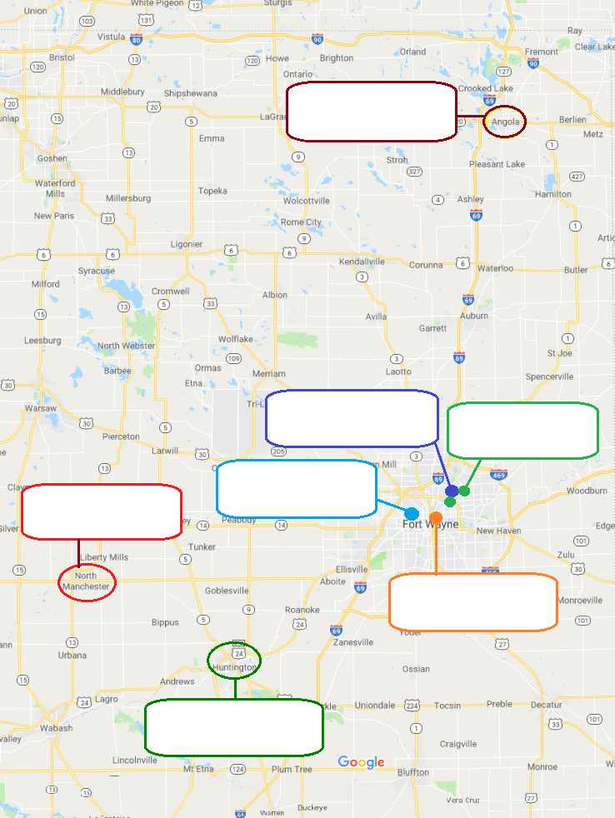
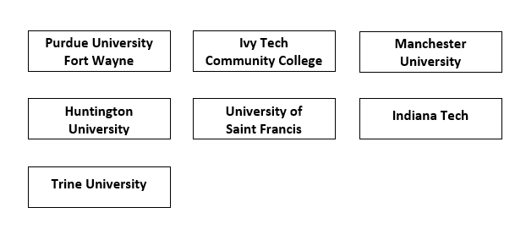
Definitions / Concepts Match

Slide 8
Classify Categories

Slide 9
Fix the Order
How do you put an elephant in your fridge?
Put the elephant inside
Close the door
Open the fridge

Slide 10
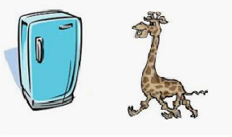
Fix the Order
How do you put a giraffe in your fridge?
Put the giraffe inside
Take out the elephant
Close the door
Open the fridge

Slide 11
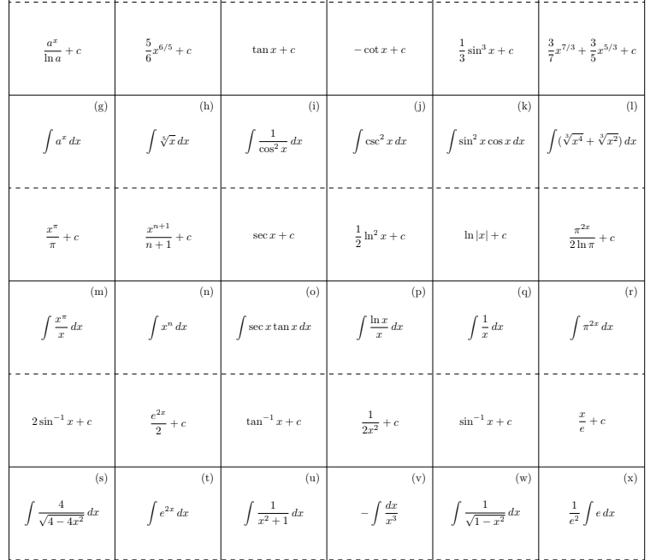

Slide 12
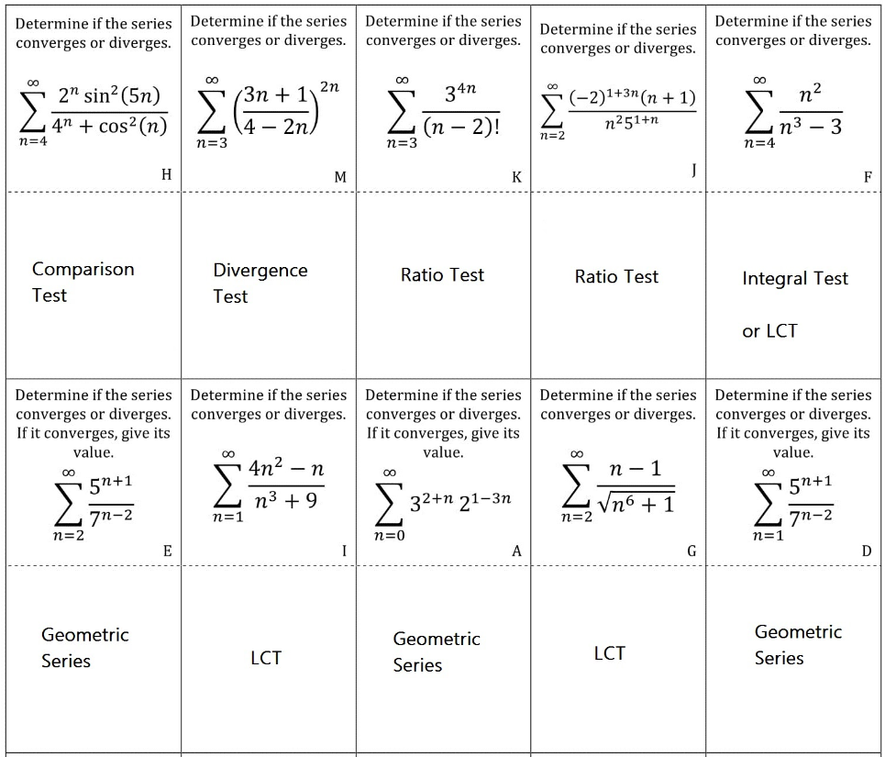

Slide 13
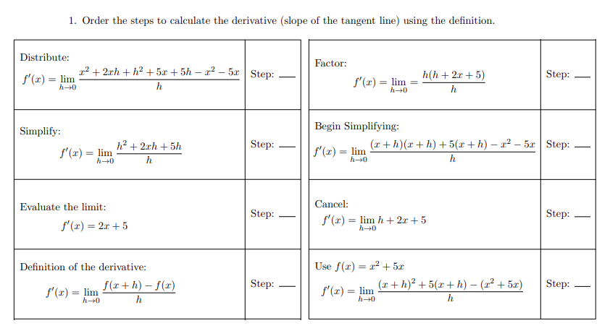

Slide 14
Students’ feedback
I think these games are a good way to learn the material. I enjoy them and better understand the information after playing
I enjoyed this activity. It showed me what I needed to work on, and after writing the answer, I was able to study those. Also, it gave more examples/ practices.
It was a fun refresher and a good break from learning new material. They helped me realize how much I need to study for the next exam.
It has really helped me think about different problems critically.
These helped me to identify when to use certain techniques to solve
I like them and they help because I can go back afterwards and study

Slide 15
Negative comments
I prefer when you go over the problems or examples better. The games are a waste of time in m opinion. My group doesn’t really try either.
They were good, they helped me see more examples but if at possible give each individual a set of matching cards so everyone can express what they learned instead of one student doing all the work
Not a bad game but confused me sometimes

Slide 16
Kahoot Game Kahoot! is a free game-based learning platform that makes it fun to learn – any subject, in any language, on any device, for all ages!

Slide 18
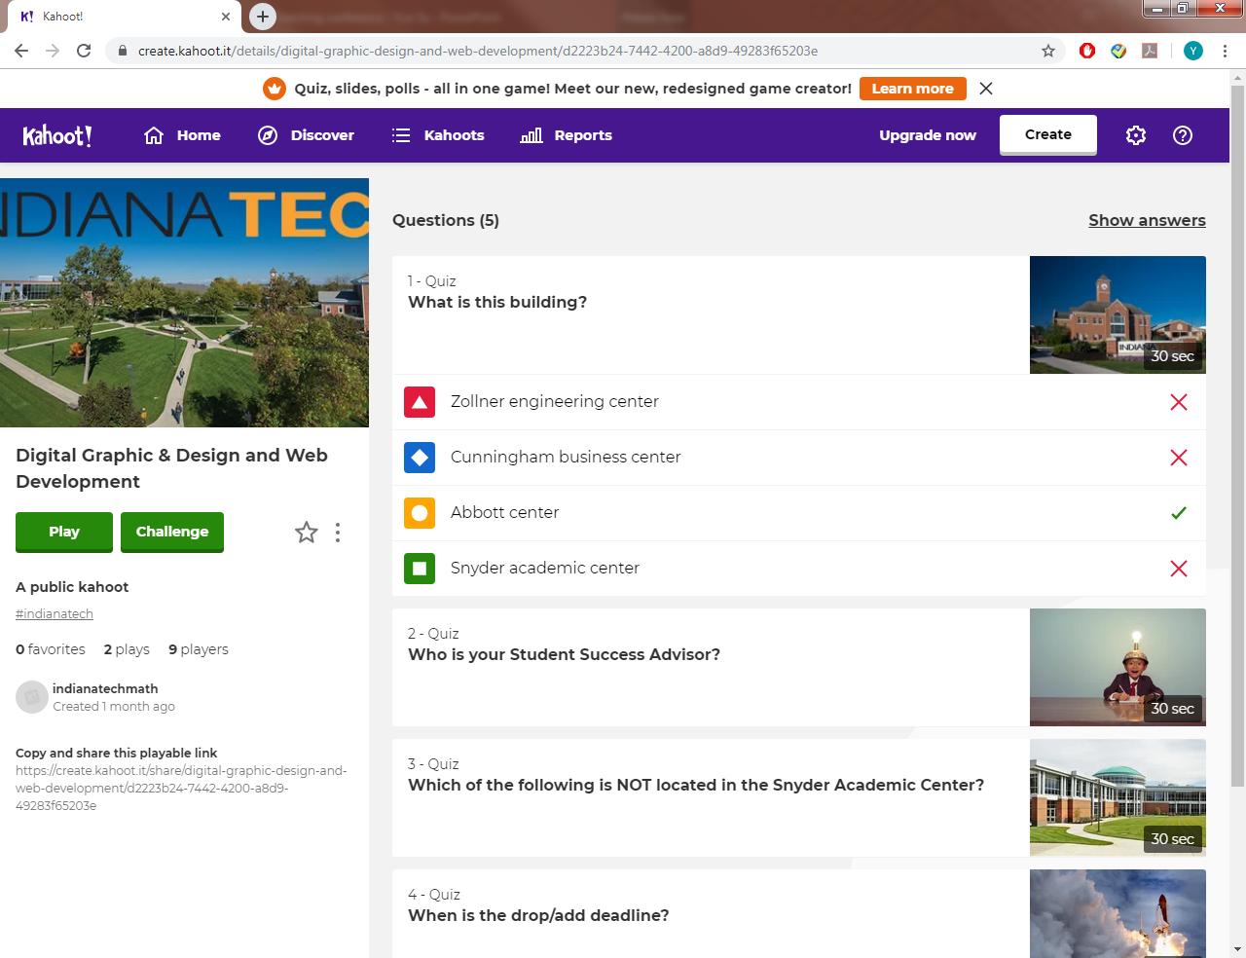

Slide 20
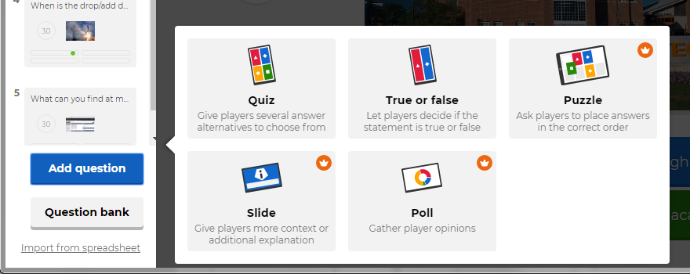
We play Kahoot Game on the exam review day.
Basic account is free, Pro ($3/month) & Premium ($6/month) accounts have more game figures.
For each question, you can choose the format to be “Quiz”, “True or False”. Pro & Premium users can choose “Puzzle”, “Slide” or “Poll” as well.

Slide 21
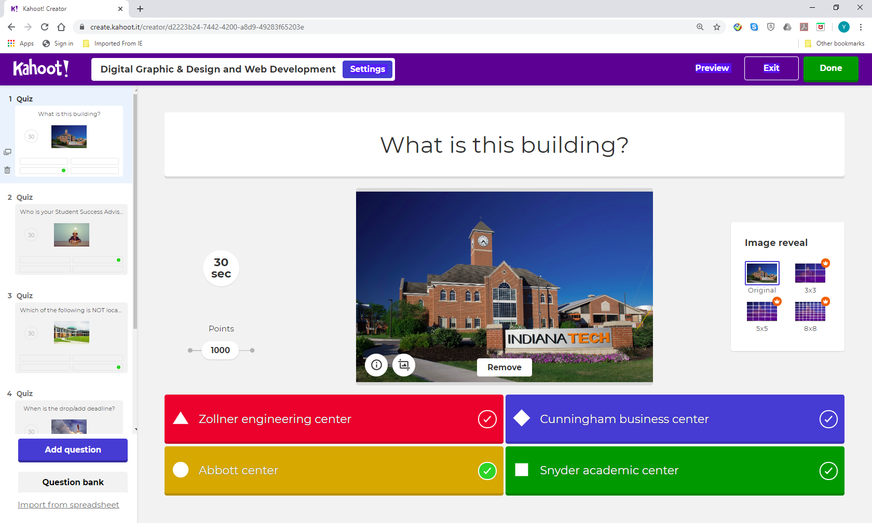

Slide 22
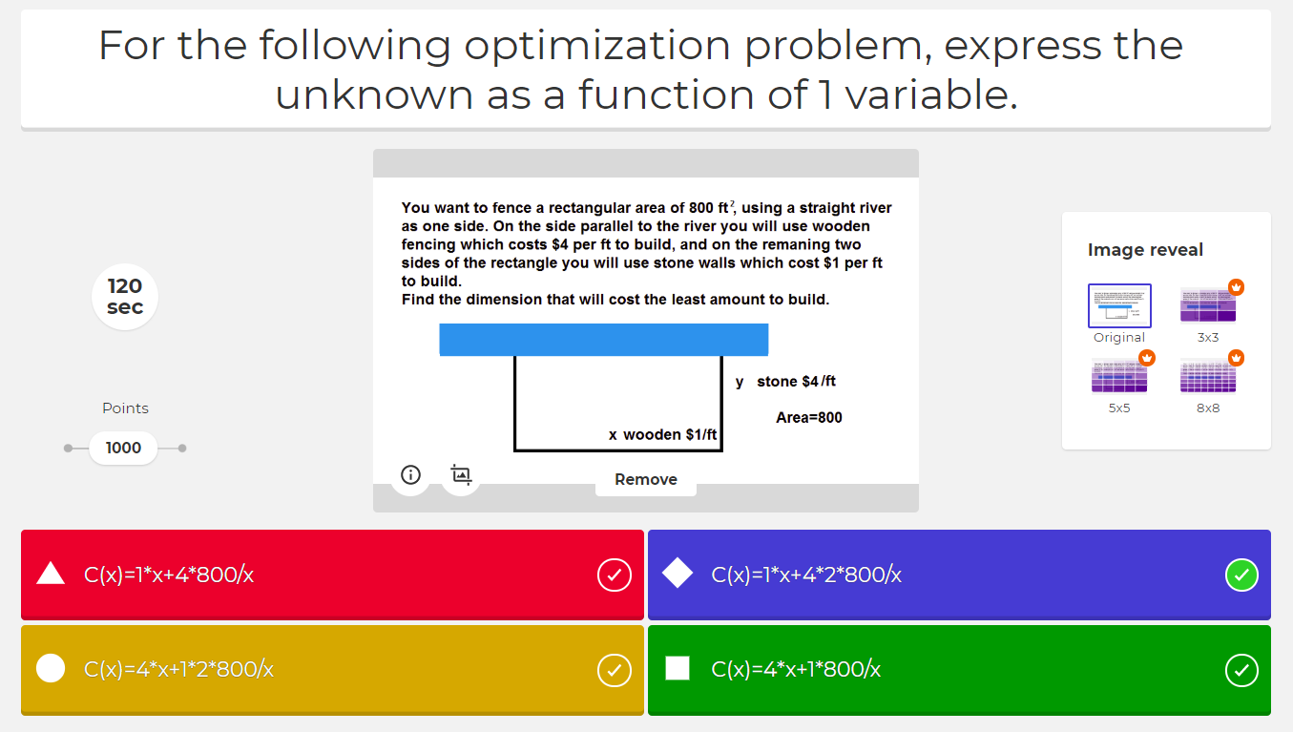
Limitation on “Quiz”
Each question can only have at most 4 choices
Each choice can have at most 75 characters.
The question can have at most 120 characters.
If you have more than 120 characters in the question, you can put them in the image.

Slide 23
Limitation on “Quiz”
Cannot type math symbols in the text box.
Write the math symbols in Word, then print screen, use Paint to make the image.

Slide 25
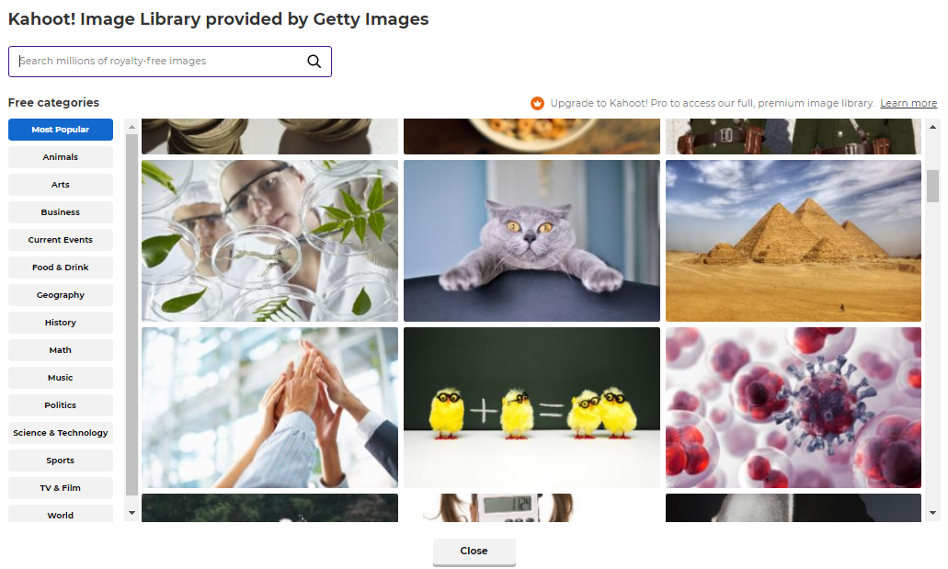
Kahoot has lots of images from the Image Library, you can choose the one you like, or you can upload image from your computer, or insert a YouTube link.

Slide 26
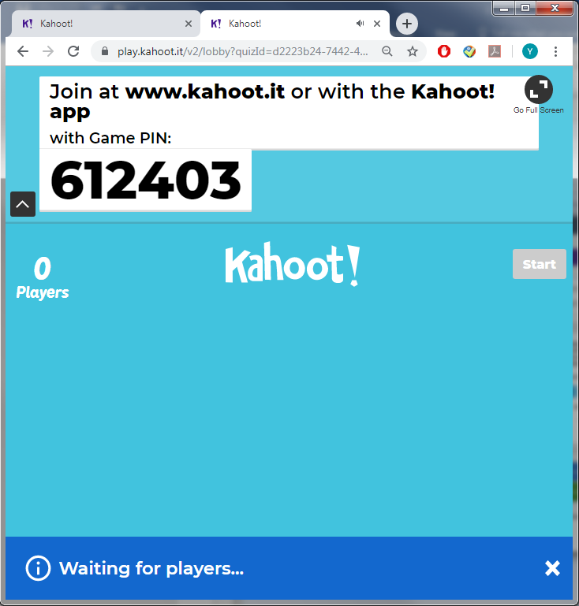

Slide 27
Students’ feedback
I like these, these are quick and fun.
It helps you think quicker to see how much you understand it.
This game was fun, allowing us to compete against other group in class.
I like the Kahoot games they help me think at a high level.
I personally liked the group Kahoot game. I learned critical thinking. I think you should do it more.
Definitely fun and enjoyable, some problems do take longer than Kahoot allows though.
They help figuring out what we should review or focus on.

Slide 28
Negative comments
I don’t like Kahoot because I would rather do practice problems on my own. the competition has added pressure and I don’t love that.
It didn’t really help me learning anything because it was timed so you had to work fast, and I typically make mistakes.
It’s difficult to do these kinds of math with that short of time. I know that there are ways to do it faster, but we don’t go over those because of the pace of the class.
I have never been a fan of Kahoot. I feel too rushed when playing. So it’s hard to think.

Slide 29
Let’s play a Kahoot Game !
https://create.kahoot.it/share/duplicate-of-international-meet-and-greet-fall-2019/2c49c894-3768-4f09-9336-10b3e23dc718

Slide 30
GeoGebra Project – Dynamic Visualizations
GeoGebra is a free interactive geometry, algebra, statistics and calculus application, intended for learning and teaching mathematics and science from primary school to university level.
Dynamic Visualizations can increase students’ conceptual understandings

Slide 31
GeoGebra Project – Dynamic Visualizations
Introduction/Guide is provided to students, students can watch assigned YouTube video to learn how to create GeoGebra projects, step-by-step screen-shots are also provided
Students’ projects are posted on course website so everyone can appreciate their work

Slide 32
Students’ GeoGebra Projects
Calculus I
1. Using GeoGebra to verify derivative as slope of tangent line pdf instructions
Project 1, Project 2, Project 3, Project 4, Project 5, Project 6, Project 7
2. Using GeoGebra to approximate definite integral pdf instructions
Project 1, Project 2, Project 3, Project 4, Project 5, Project 6, Project 7

Slide 33
Students’ GeoGebra Projects
Calculus II
1. Using GeoGebra to Visualize Solid of Rotation pdf instructions
Project 1, Project 2, Project 3, Project 4, Project 5, Project 6, Project 7, Project 8, Project 9
2. Using GeoGebra to Draw Slope Field and Solve ODE pdf instructions
Project 1, Project 2, Project 3, Project 4, Project 5, Project 6, Project 7, Project 8
3. Using GeoGebra to Graph Polar Curves and Parametric Curves pdf instructions
Project 1, Project 2, Project 3, Project 4, Project 5, Project 6, Project 7

Slide 34
Students’ GeoGebra Projects
Calculus III
1. Using GeoGebra to Draw Parametric Curves pdf instructions
Project 1, Project 2, Project 3, Project 4
2. Using GeoGebra to Draw 3D Curves and Surfaces pdf instructions
Project 1, Project 2, Project 3, Project 4
3. Using GeoGebra to Draw Vector Field and Gradient Field pdf instructions
Project 1, Project 2, Project 3

Slide 35
Students’ feedback
It was entertaining.
These help so much in this class where we are dealing with 3D objects. For me the imagining of theses shapes is hard, so these help.
It helps because it gives you a visual representation of how the problem works.
I like them. I think it’s a good way to help everyone visualize what we are learning . This way we can put a picture to the work.
I like them I did one and enjoyed it. I am excited to do the others.
This was a great visual to the concepts. After doing the first one I was able to understand how shell and disc method work.
Great examples, especially for area under curve problems.

Slide 36
Negative comments
GeoGebra works different on each computer so it’s hard to find the features on some.
The pictures of the instructions do not match the new website, making it hard to understand.

Slide 37
Bond with Students First-Day Questionnaire
Alex McAllister at MAA MathFest 2019
Course Number ______________________________
Write your name ______________________________
List your year in college. _____________________________
Where are you from? _____________________________
List one or two things that are important in your life.
What is the last math course you have taken?
What would you like me to know about your individual experiences learning math?

Slide 38
Expectations
Thoughtfully reflecting on what you looking for from others and yourself as you begin any activity can be incredibly valuable. We can learn what we are looking for, hoping for, and need, both with respect to ourselves and with respect to others. Identify at least three expectations you have for each of the followings:
Expectation of yourself:
1) 2) 3)
Expectation of your peers:
1) 2) 3)
Expectation of your professor:
1) 2) 3)

Slide 39
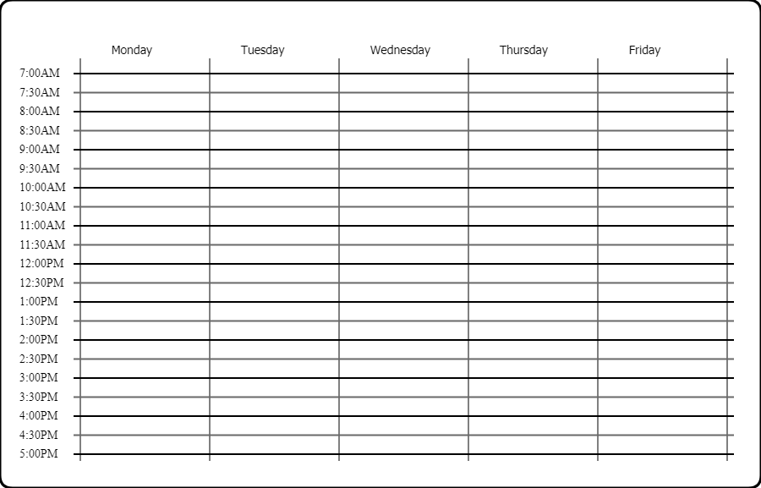
What is your schedule for this semester?
Please write down your schedule, draw rectangles to indicate all of your courses or your part-time jobs. This would help me to contact you or schedule appointments with you when necessary. ☺
My office hours are MWF 9:00 am – 10:45 am, 12:45 pm – 1:45 pm Or if you can’t come at that time, please email me (ysu@indianatech.edu) to schedule an appointment. Thanks!

Slide 40
Students’ Answers What would you like me to know about your individual experiences learning math?
I do better when we work through examples as a class.
I like math!
Math is very fun, but matrices are kind of weird.
I learned best by taking notes and doing many examples in class on how to do all problems.
Students like examples.

Slide 41
Students’ Answers What would you like me to know about your individual experiences learning math?
I don’t like math and especially not its complexity. However, I appreciate that there is always a correct answer or set of correct answers.
I’m bad at memorizing most formulas.
I can overthink a math problem and get it wrong.
My last two years on math were online, so it was pretty much watching videos and learning like that.
Students’ difficulty in learning math.

Slide 42
Students’ Answers What would you like me to know about your individual experiences learning math?
It was pretty easy for me until I got to maximum and minimums through derivatives
I always had trouble with Trig.
I had difficulty learning in previous classes.
Provide extra practices about these topics.
Talk to the students in person to help them.

Slide 43
Students’ Answers Expectation of yourself:
Understand the concepts of the course
Do well in the course
Take thorough notes
Ask questions if I’m confused
Do all the work on time
To understand the material and how it relates to the course
To try my hardest
To seek out help if I need it
To get to know my professor and peers
Be considerate of others
Not use my phone in class

Slide 44
Students’ Answers Expectation of your peers:
Help me with something I struggle with
Study together for quizzes/ exams
Work as a team
Everyone will try to learn
Be respectful
To be friendly to all
To give their best and do their own work
Don’t distract me while I’m in class
Don’t cheat
Don’t complain about failing if you never study and don’t pay attention.
No sleeping in class, stay off phone

Slide 45
Students’ Answers Expectation of your professor:
Be available for questions/ help
Work with me on make up work/ planning exams if I have a sporting event.
Make sure no one is left behind
To try their hardest to get to know me
To have a good relationship with students
Teach the class well and explain confusing topics.
Lots of examples
To stay on top of putting in grades

Slide 46
Students’ Answers Expectation of your professor:
Enjoy covering the material in class
Helpful, energetic, knowledgeable
To be engaging and make the material interesting to learn
To be understanding
Have a passion
Be fair
To be able to challenge me in a reasonable way
Take your time and don’t rush

Slide 47
Exam Wrapper – help students to improve through self-reflections
Senan Hayes, Alicia Maloney, at MAA MathFest 2017
Exam Wrapper
The main goal of this questionnaire is to help you improve in this class.
Step One: Understand the course concepts.
Please keep in mind that the pace of the course is brisk and continuous, mainly so that we are able to cover all the required material. If you feel that you are falling behind, it means you will have to be prepared to work that much harder in order to be successful.
Do you understand what we taught in class (problems in the worksheet, concepts)?
percentage: ______________
If your answer is not 100%, please pay MORE attentions to the following questions:
All of the worksheets are posted on our course website, so you have an idea about what we will go over in each class. Do you read your textbook about the corresponding section before coming to class? Yes No

Slide 48
Do you take notes in class? Yes No
Do you review the notes after you get home? Yes No
When you work on your homework problems, after clicking the solution, do you use red pen to continue to write down the corrections (in this way, you can see your mistakes)?
Yes No
When you do not understand some concept or problem in the homework, did you email me or come to ask me in my office hours?
Yes No NA ( you can choose NA if you understand everything. ^o^ )
If you have conflict with my regular office hours, have you tried to email me to schedule an appointment? Yes No NA

Slide 49
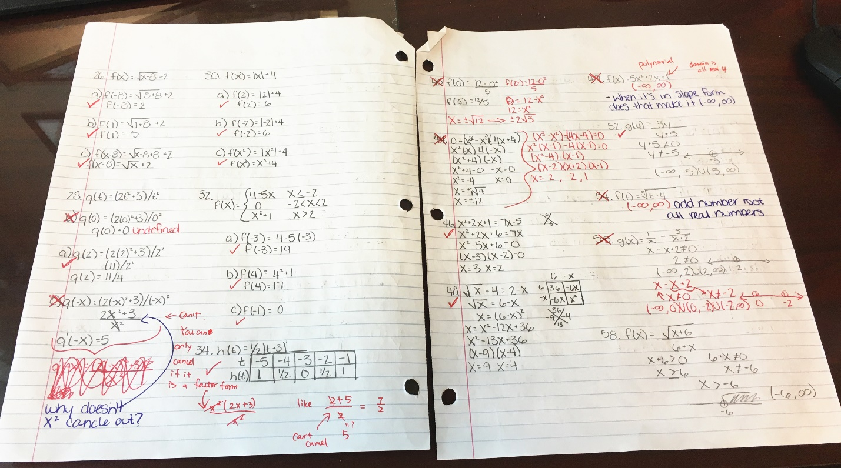

Slide 50
Step Two: Prepare for the exams
About how many hours did you spend preparing for this exam? ________________
On how many different days did you study for this exam? _______________
Did you study by yourself or with one or more other students? Circle one.
If you did both, indicate the % of time :
alone _____________ and with others ________________
When you started studying for this exam, what did you study first?

Slide 51
When you were studying for this exam, how much time did you spend on each of the following topics?
Reviewing your class notes? ______________
Reviewing your homework and quizzes mistakes? ______________
Memorizing formulas? ______________
Reworking exercises from the homework? ______________
Taking self-assessments? (like the practice exam) ______________
Doing personalized practice homework(s)? ______________
Other (please describe) ________________________________________________

Slide 52
Step Three: Learn from our mistakes
What mistake(s) did you make on the exam that taught you something? Describe the mistake and tell what you learned from it.
Based on your mistakes, what will you do differently in preparing for the next exam?
What can I ( the professor) do to help you master this material better?

Slide 53
Students’ Answers What mistake(s) did you make on the exam that taught you something? Describe the mistake and tell what you learned from it.
Mixed up the formulas. I need to slow down and better understand the formulas so I don’t just try to memorize.
I focused too much on the earlier sections, wo when I got to the later portions the formulas that I crammed in were forgotten. I learned that I need to focus more on understanding why something works rather then just its formula.
I spent too much time on each problem so at the end I had to rush and try to put something for each problem to get partial credit.
I made a lot of little mistakes such as forgetting to cube something. This taught me to slow down to make sure I am doing everything correctly.
Write my work even when I may think I am wrong.

Slide 54
Students’ Answers Based on your mistakes, what will you do differently in preparing for the next exam?
Take more time to understand material after it is taught.
Study more time.
Refresh myself on basis.
Study sooner, do quizzes again. Study more but spread it out.
Spend more time memorizing formulas and trig identities
I will make sure to get a good night sleep before the exam so I don’t have a bunch of little mistakes because I’m tired.
Take longer to review the notes and quiz mistakes. Do not wait last minute to start studying.

Slide 55
Students’ Answers What can I ( the professor) do to help you master this material better?
If anything, I would prefer multiple recaps of the theory when we finish examples in class so that I have more reference. ☺
Slow down sometimes.
Make the homework more like the questions on the test
Nothing really, we are behind schedule so we can’t really slow down, so the only thing is to review more (personally).
Nothing, I need to put more effort into studying and start studying sooner in order for information to click and know exactly what I am doing
Nothing, it was my stupid mistakes that caused me to get points marked down. I understand my mistakes.
I think you are going a good job. ☺
You did excellent!

Slide 56
Students’ feedback
They help focus on our mistakes in the test instead of just working over our grade
It forces me to look back at my work to find the mistakes in depth. I wish I could apply this to other classes! They definitely help.
I like them and they help me reflect on my studying habits.
The exam wrappers help expose to me where my weaknesses are and let me know where I can improve in my tests
They allowed us to communicate our feeling about the exam to you.
It makes me see how much time I spend studying and what I need to improve on.
I like them because it reminds me of other options of studying.

Slide 57
Negative comments
They are kind of tedious, but necessary for you to understand what we do.
They don’t really help with my learning, just how I divided my time for the exam
They’re ok, reflective. But I don’t think it changes much.

Slide 58
References
Hodge, A., Wanek, K., & Rech, J. (2019). TACTivities: A Tactile Way to Learn Interdisciplinary Communication Skills. PRIMUS. https://doi.org/10.1080/10511970.2018.1532937
Alex McAllister, Centre College, Learning about Learning, MAA MathFest 2019
Senan Hayes, Alicia Maloney, Western CT State University, Using Exam Wrappers to Improve Student Outcomes, MAA MathFest 2017

Slide 59
Q & A Thank you for coming!
Please scan the QR code for slides and materials.
If you have any questions, please contact me at
Ysu@indianatech.edu

