Slide 1
Unlocking Grit & Growth Mindset in a Graduate Curriculum
Joshua Fairbanks, DMSc, PA-C |
Interim Program Director
jfairbanks@sf.edu
Courtney Lloyd, Ph.D.
Assistant Professor
clloyd@sf.edu
Department of Physician Assistant Studies
University of Saint Francis | Fort Wayne, IN
Notes:
Baby bear video
What did you observe from this little bear?
1) Baby Bear never stops trying.
Every time Baby falls, he immediately starts back up the mountain with a new plan. Each time, he gets a little smarter about how to keep his grip and reach his goal to the top of the mountain.
2) Mama bear is at the top of the mountain, and she does not come down the mountain to help Baby. Why? Maybe because this would put them both in danger. Maybe because if Mama came to the rescue, Baby Bear wouldn't have learned how to succeed on his own.
3) The one time that Mama even reaches out for Baby, is the time that he slides back the furthest on the mountain!
Did he get distracted? Start to doubt his own ability and think that Mama would do the rest of the work? Notice, too, that the time he succeeds in getting to the top of the mountain, she completely leaves him to his own devices! It wasn't until he figured out how to do it all on his own, recovering from the longest fall, that he was finally successful!
We hope this little bear inspires you as you pursue your goals this semester.
How will you start back up the mountain when you fall? Will you believe in yourself so much that sliding off the mountain is not even an option? Will you keep going, even after "failures," and will you embrace those failures as a part of the process? Will you develop grit by digging into your passion and perseverance?
Ever have a student who has so much potential but is constantly struggling?
What about the student who despite a rough undergraduate transcript, is constantly fighting tooth and nail to succeed in your program?
Difference in MD vs PA vs NP?

Slide 2
Disclosures
The presenters have no conflicts to disclose.

Slide 3
Session Objectives
Throughout this workshop, attendees will:
Define ‘grit’ and ‘mindset’ as student success characteristics.
Explore the latest research regarding the role of grit and mindset in the development of critical thinking skills.
Collaboratively brainstorm innovative ways to incorporate grit and mindset into their pedagogical application, educational models, and didactic curriculum.

Slide 4
The Balance of Graduate Education
Encouraging Growth
Challenging Academics
“Gritty” Students
Growth Mindset
Critical Thinkers
Notes:
Dichotomy that involves a careful balance between overwhelming our students with knowledge and yet still encourage their emotional, mental, & spiritual development.
Only when balanced appropriately can we reach our goal of helping our students develop tenacity, utilize a growth mindset, and become great critical thinkers.

Slide 5
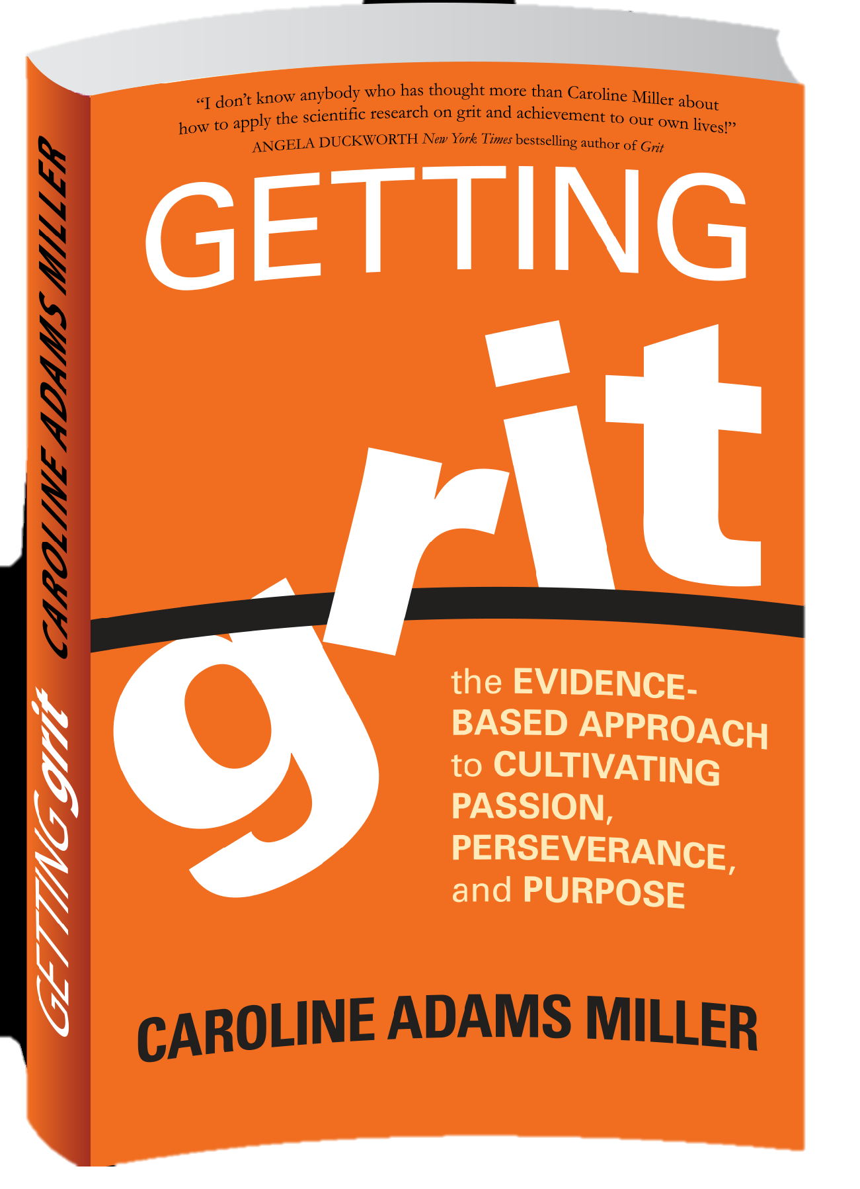
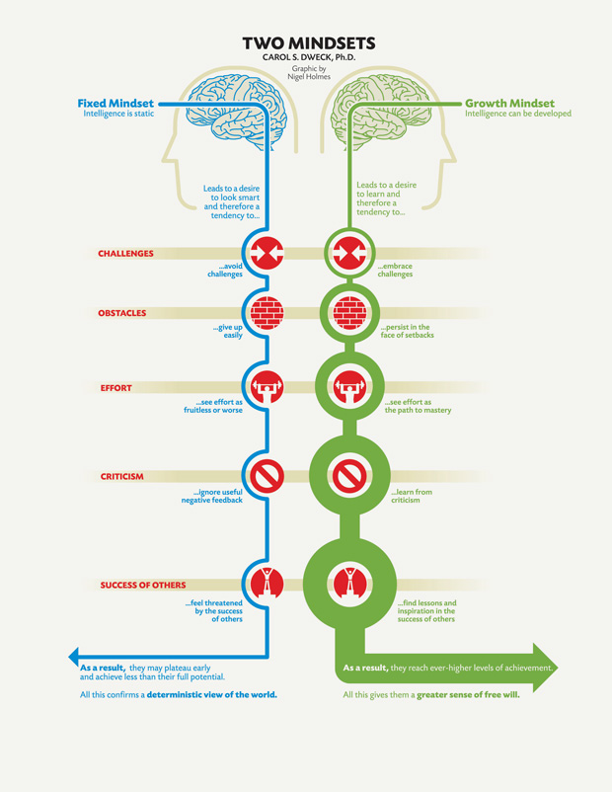
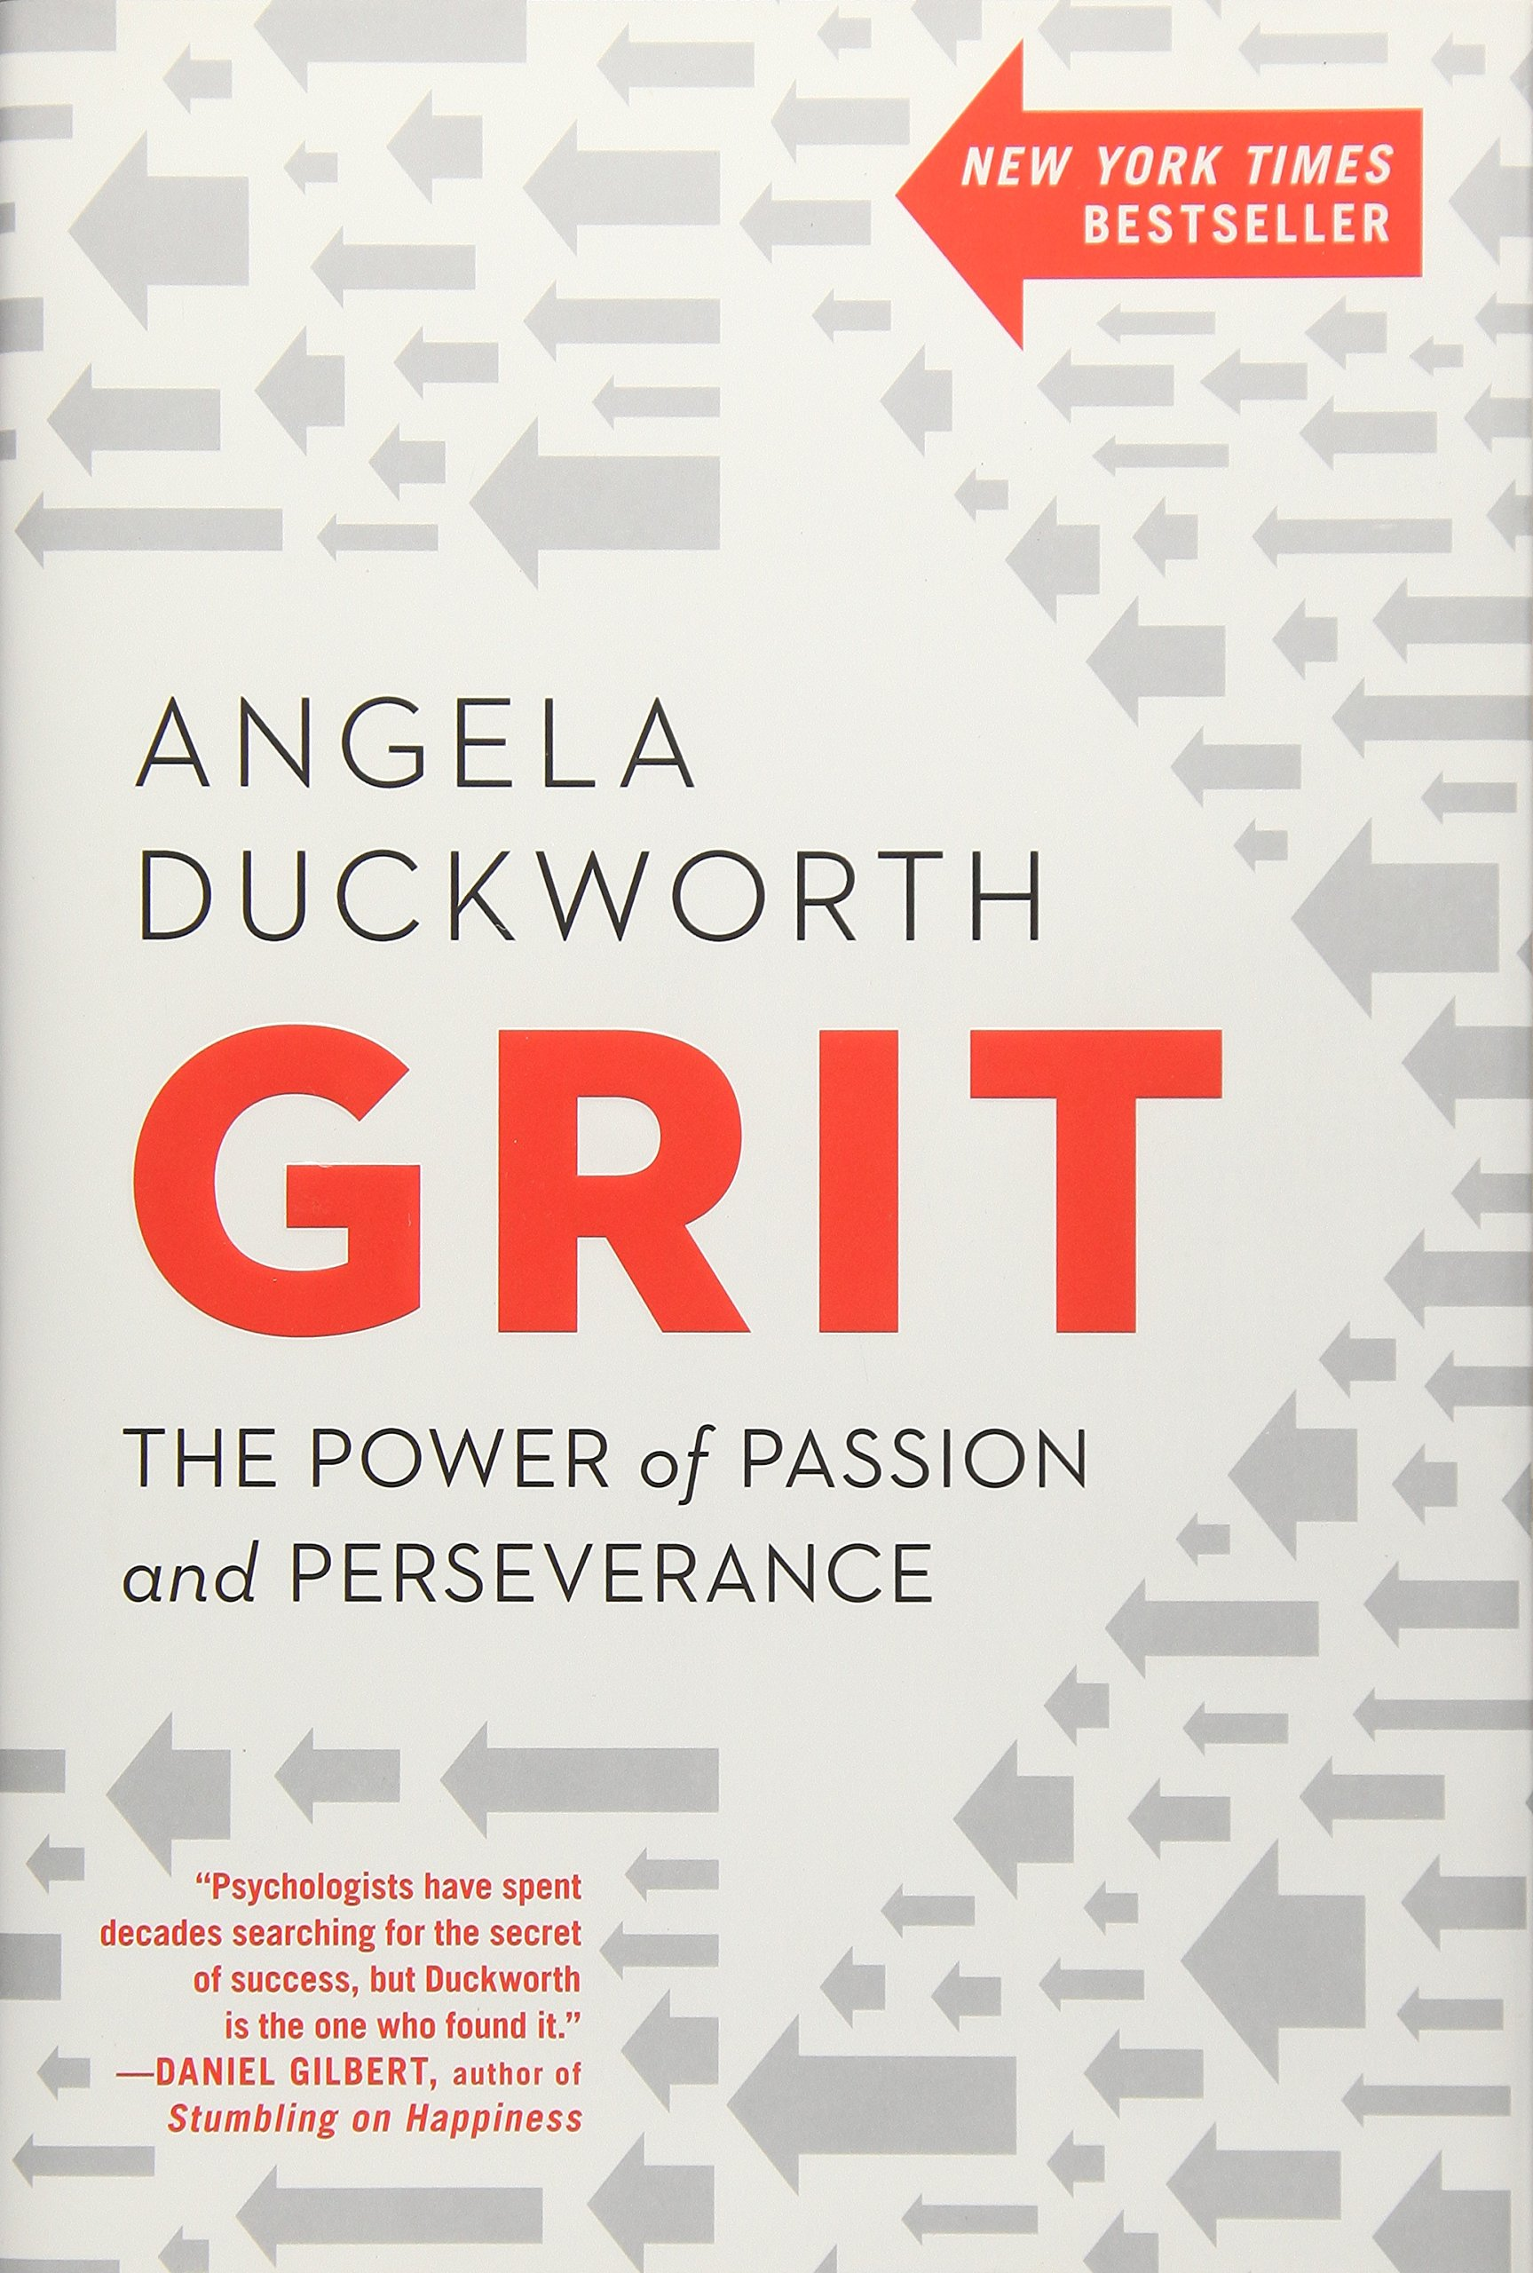
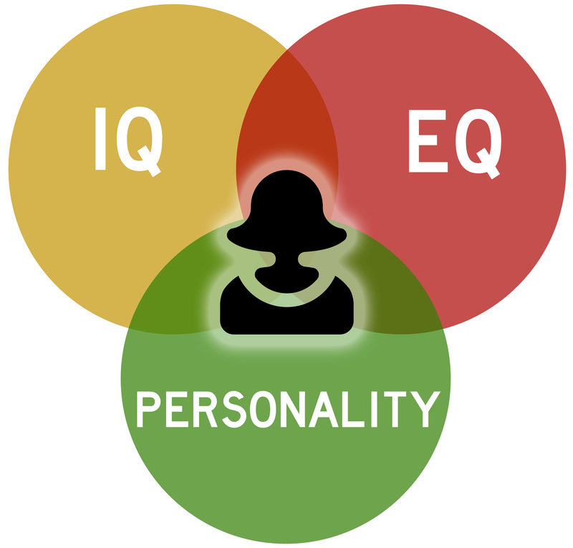
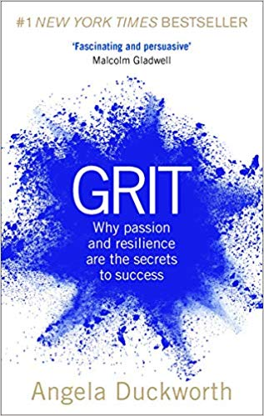
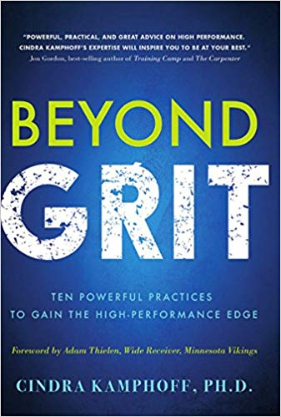
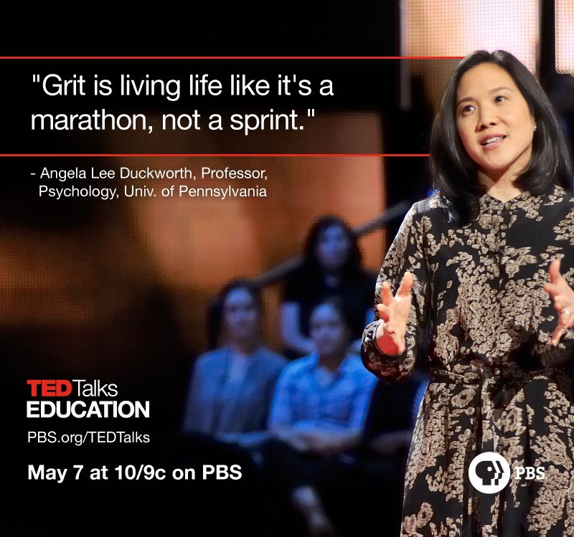
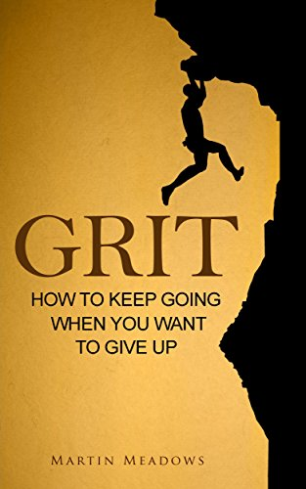
Why do we care?
The influence of personality traits and intelligence on student success has been well researched.
Angela Duckworth’s work on the concept of ‘grit’ and its correlation to academic success has risen to center stage in research.¹
Carol Dweck has dedicated her research to the concept of mindset and how it plays a role in success.²
Dr. Saundra McGuire notes that having grit and a growth mindset are major components to developing critical thinking in students.³
Grit
Growth Mindset
Critical Thinking
¹Duckworth AL, Peterson C, Matthews MD, Kelly DR. Grit: Perseverance and passion for long-term goals. J. Pers. Soc. Psychol. 2007;92(6):1087-1101. doi: 10.1037/0022-3514.92.6.1087.
²Dweck CS. Mindset. Updated ed. New York: Ballantine Books; 2016. ³McGuire S. Teach students how to learn. 1st ed. Virginia: Stylus Publication; 2015.
Notes:
Many domains have been studied to gain further insight into how we can predict student's success in rigorous professions as well as academic programs.
Old emphasis of success was on personality traits and IQ.
New emphasis looks at the adaptability of a student. Grit and Mindset. This is evident by the number of recent publications and appearances on TEDtalk and here at PAEA.
We are starting to see an increase in the among of emotional intelligence, personality inventories, and even grit scales that are being utilized by universities to help them to narrow in on the students who can be challenged academically and succeed.

Slide 6
Defining Grit
“Perseverance and passion for long-term goals”.¹
Self-control is utilized to achieve short-term goals in spite of difficulties faced, but grit is committing to a goal no matter the obstacles that may arise.¹
¹Duckworth AL, Peterson C, Matthews MD, Kelly DR. Grit: Perseverance and passion for long-term goals. J. Pers. Soc. Psychol. 2007;92(6):1087-1101. doi: 10.1037/0022-3514.92.6.1087.
Notes:
Before we can jump into the research over grit and its role in academic success, it is important to first nail down a solid definition.
Although it is closely related to self-control, that are indeed distinct traits.
Self-control is continuing to study for the SAT even when your friends are going out because you know the end (exam day) is in sight.
Grit is studying medical texts every day because you never want to miss a diagnosis, and never knowing if that information you are currently studying will ever be used.

Slide 7
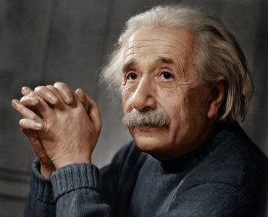
Examples of Gritty Individuals
Bethany Hamilton
Albert Einstein
Bill Gates
Notes:
Bethany Hamilton
Are you scared of sharks? Bethany came face to face with one and still got in the waters again. When she was 13, Bethany Hamilton was surfing and got attacked by a shark. It chewed off her left arm but she survived. Believe it or not, Bethany was back in the waters one month later. In two years, she was the overall winner in the Explorer Women's Division in the NSSA National competition. Her grit and determination were simply impressive.
Albert Einstein
No other name in human history has been associated with intellectual achievement like Albert Einstein's. Widely regarded as the father of physics, Albert is a scientific celebrity all over the world. In his early days, nobody thought he would grow into a genius. Albert did not talk until he was 4 years old. He also could not read until he was 7. His parents and teachers thought he was mentally handicapped. He was once expelled from school for the same reason and also denied entry into the Zurich Polytechnic School. Through enterprise and interest in science, he found a place in the educational institutions and rose to become the scientist we know today.
Bill Gates
Many people know him as the richest man in the world. Few know that his first product was an epic failure. Bill and a friend named Paul Allen created a device that could read traffic data and interpret it. They called it Traf-O-Data. When they went to market, their device had multiple malfunctions and was a failure. Instead of giving up, the dynamic duo went back to the drawing board and Microsoft was born. The rest is history.

Slide 8
How gritty are you?
Notes:
Now that we have a better understanding of what grit is, let’s find out how gritty we are!
Angela Duckworth’s grit scale.
Give about 7-10 minutes

Slide 9
The Establishment of Mindset
Carol Dweck classifies people into two categories of mindset:²
Fixed Mindset
Growth Mindset
Intellect, ability, and success are rigid characteristics
Intellect, ability, and success can be fostered through effort and support
Perceive ‘failure’ as the limit of one’s ability
Approaches a situation that others may claim as a ‘failure’ and views it as a learning experience
²Dweck CS. Mindset. Updated ed. New York: Ballantine Books; 2016.
Notes:
Fixed mindset
Believes that a person’s intellect, ability, and success are all rigid characteristics a person is innately born having ingrained within them.
Examples??
Growth mindset
On the other hand is based on the belief that these characteristics can be fostered through effort and support.
Examples??
With this shift in understanding of how mindset can set the tone for learning, we have seen an increase in research in learning theory and how to utilize growth mindset in the classroom. Students with a fixed mindset are at a significant disadvantage to their counterparts who believe that hard work can develop intelligence (growth mindset).
A student with a fixed mindset may look at a C grade in chemistry and believe that they just aren’t good at chemistry, where as a growth mindset student may look at that C as an opportunity to continue to expand their knowledge base. A growth mindset looks at a situation that others may claim is a failure and approaches it as a learning opportunity.

Slide 10
What is your MINDSET?
Notes:
Give 7-10 minutes

Slide 11
Connecting Grit, Growth Mindset, & Critical Thinking
Study
Talent alone does not explain excellence, but rather one’s dedication to deliberate practice and study.
This dedication is known as engagement, or emotional involvement in the task.
Students that are more engaged tend to have a growth mindset because they are drawn to self-directed and autonomous learning opportunities which in turn fosters grittiness.
Engaged
Engagement
Dedication
Growth mindset
Talent
Excellence
Grittiness
Notes:
Remember those students we talked about the beginning? Students with “potential” talented yet unmotivated.
Geniuses are developed over time by a persistent dedication and engagement with a long-term goal. Recall this is what Angela Duckworth calls grit.
Engagement techniques:
Self-directed lectures
Optional videos/assignments
Volunteering at a clinic after school hours

Slide 12
Connecting Grit, Growth Mindset, & Critical Thinking
Engagement
Stronger growth Mindset
Enhanced Grittiness
Critical thinking skills
When students are encouraged to fight through adversity and see “failure” as a learning opportunity, they develop growth mindset which in turn improves their grit.^{4,5}
When students realize that their mindset can affect their abilities, intelligence, and ultimately their outcomes they are more aware of learning and ultimately develop critical thinking skills.⁴
Research has also shown that when students are engaged and aware of their mindset, educators can guide them to develop a stronger growth mindset, more grittiness, and deeper critical thinking.⁵
⁴Hochanadel A, Finamore D. Fixed and growth mindset in education and how grit helps students persist in the face of adversity. JIER. 2015;11(1):47-50. https://eric.ed.gov/?id=EJ1051129.
⁵Duckworth A, Gross JJ. Self-control and grit. Curr. Dir. Psychol. Sci. 2014;23(5):319-325. http://journals.sagepub.com/doi/full/10.1177/0963721414541462. doi: 10.1177/0963721414541462.
Notes:
These research studies show that growth mindset can help lead to the development of grit, but what role do these play in critical thinking?
Critical thinking is a mode of thinking about any subject, content, or problem in which the thinker improved the quality of his or her thinking by skillfully analyzing, assessing, and reconstructing it. Critical thinking is self-directed, self-disciplined, self-motivated, and self-corrective thinking. This may sound very similar to metacognition with is defined as awareness or analysis of one’s own learning or thinking process. Or as Dr. McGuire defines it: Thinking bout your own thinking.
Why is this important? Metacognition gives the students four abilities
The ability to think about one’s own thinking
The ability to be aware of oneself as a problem solver
The ability to monitor , plan, and control one’s mental processes
The ability to judge one’s level of learning

Slide 13
LET’S BRAINSTORM!
Notes:
With this background information, it is evident that these characteristics play powerful roles in student learning, but how can physician assistant programs utilize this information?
Lets discuss!

Slide 14
1) How can grit and growth mindset be utilized to predict student success or trigger early remediation?
2) How can we incorporate grit, growth mindset, and critical thinking skills into our courses and curricula?

Slide 15
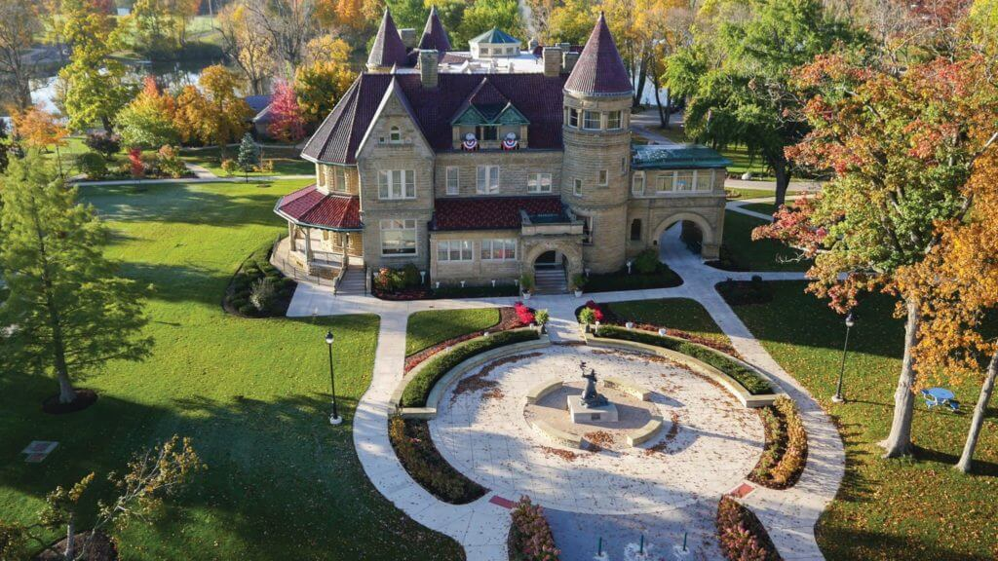
The University of Saint Francis PA Program
Catholic University in the Franciscan Tradition
25 students/cohort
May start date
27-month curriculum

Slide 16
USF’s Approach to Grit and Mindset
USF’s PA Program utilizes several active learning strategies to develop grittiness, a growth mindset, and advanced critical thinking skills:
Team-based learning
Problem-based learning
Group presentations
Active Learning Curriculum
Case studies
Lecture on mindset
Guide-on-the-
side
Notes:
Discussion….from research?
TBL in HSF/Patho
Group presentation in Pharm 2
Study technique discussion during meetings
Guide-on-the-side in CPS
Case studies for Simulation and Standardized Patients
PBL curriculum

Slide 17
Questions?

Slide 18
References
Duckworth AL, Peterson C, Matthews MD, Kelly DR. Grit: Perseverance and passion for long-term goals. J. Pers. Soc. Psychol. 2007;92(6):1087-1101. doi: 10.1037/0022-3514.92.6.1087.
Dweck CS. Mindset. Updated ed. New York: Ballantine Books; 2016.
McGuire S. Teach students how to learn. 1st ed. Virginia: Stylus Publication; 2015.
Hochanadel A, Finamore D. Fixed and growth mindset in education and how grit helps students persist in the face of adversity. JIER. 2015;11(1):47-50. https://eric.ed.gov/?id=EJ1051129.
Duckworth A, Gross JJ. Self-control and grit. Curr. Dir. Psychol. Sci. 2014;23(5):319-325. http://journals.sagepub.com/doi/full/10.1177/0963721414541462. doi: 10.1177/0963721414541462.

