Slide 1
But I am Really Tired and Hungry Right Now: Listening Behavior in the College Classroom
Mary Lahman
Professor of Communication Studies
Manchester University
mplahman@Manchester.edu
Susan Klein
Professor of Chemistry
Manchester University
sjklein@Manchester.edu

Slide 2
LISTENING CHALLENGE:
How important is listening for the success of your job?
In 2 words or less, list factors that might affect your ability to hear and process what we say today.
Notes:
https://www.polleverywhere.com/free_text_polls/bi25zmH6oZenY66H0RHbr

Slide 3
Notes:
Poll Title: In 2 words or less, list factors that affect your ability to hear and process what we say today. https://www.polleverywhere.com/free_text_polls/bi25zmH6oZenY66H0RHbr

Slide 4
Korzybski’s Structural Differential

Slide 5
Our Structural Differential: Aligning the structure of our language with EACH classroom in which we find ourselves
Things Professor says in class
Practice / reinforce concepts
Assemble understanding
Interpret what it means
Ask questions

Slide 6
Research Question
To what extent does an awareness of automatic thinking processes impact student ability to listen in the college classroom?

Slide 7
Hypothesis
Students can make plans to address factors that get in the way of listening once they have an awareness of automatic thinking processes.

Slide 8
Method
Sample:
45 students in a 100-level Comm Course
19 students in a 300-level Listening Course
44 students in a 300-level Chemistry Course
Data Collection: Anonymous Responses on Poll Everywhere
Data Analysis: Grounded Theory

Slide 9
Factors That Affect Listening

Slide 10
Factors That Affect Listening

Slide 11
Revised Structural Differential Aligning the structure of our language with the classroom in which we find ourselves
Physiological
Things Professor says in class
Psychological
Practice / reinforce concepts
Environmental
Course Content
Assemble understanding
Technology
Interpret what it means
Ask questions
Nonverbal Cues
Identity Labels

Slide 12
At Midterm
Students made plans to address the factors that get in the way of listening.

Slide 13
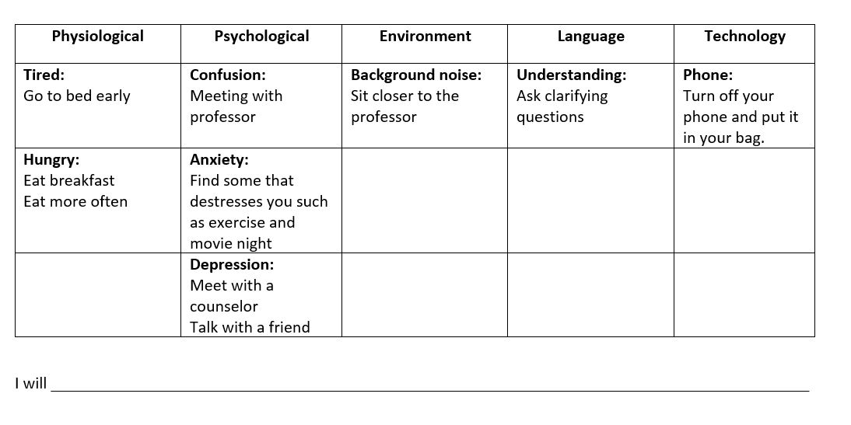
COMM Class Intentions

Slide 14
Most Popular Intentions
Psychological: Stress, Life, Daydreaming
Use good time management to be prepared (28)
Focus on speaker by tying what you are thinking to what they are saying (9)
Understand that things happen good & bad (7)
Find something that de-stresses you such as exercise, movie night, relaxation (5)
Be mindful so your emotions won’t disrupt you (4)
Physiological: Hungry & Tired
Find time during the day to take a 20-30 minute nap (10)
Go to be early (9)
Try to keep food or drink with you to provide more energy (9)
Try to stay active in class to keep from falling asleep (8)
Meditate (7)
Eat breakfast (6)

Slide 15
Most Popular Intentions
Environment: Noise, People, Room
Turn off Phone (12)
Do not talk (4)
Sit closer to the professor (3)
Course Content: Language, Previous Knowledge
Ask clarifying questions for understanding (3)
Find words that relate to college students for meaning (2)
Communicate effectively by saying what you are feeling (2)

Slide 16
Our Structural Differential: Aligning the structure of our language with EACH classroom in which we find ourselves
Things Professor says in class
Practice / reinforce concepts
INTERNAL NOISE
Assemble understanding
EXTERNAL NOISE
COURSE CONTENT
Interpret what it means
Ask questions

Slide 17
What intention will you set based on the factors that got in the way of your listening today?

