Slide 1
Supplies
Handout
Multiple choice cards

Slide 3
Please sit next to at least one other person

Slide 4


Multiple Choice Questions for Subject Matter Novices, an Application of Small Teaching
Presenter: Dr. Gary Greene, Ph.D., P.E., Trine University
2020 Fort Wayne Teaching & Learning Conference

Slide 5
My Story

Slide 6

Discussion Question
How do you evaluate what your students are learning during a class meeting?
Think – Write – Share
Image by ElisaRiva from Pixabay

Slide 7

Discussion Question
How do you ensure that your students are engaged with your material during a class meeting?
Think – Write – Share
Image by Peggy und Marco Lachmann-Anke from Pixabay

Slide 8

Recall Question
What was the term used in my opening story to describe pulling previously learned information out of our brain?
  Remembering
  Recalling
  Retrieval
  Reconciling
Image by Peggy und Marco Lachmann-Anke from Pixabay

Slide 9
My old format for a class meeting…
Topic
Example 1
Example 2
A
B
C

Slide 10

Discussion Question
What are some potential problems with this style of teaching?
Image by TeroVesalainen from Pixabay

Slide 11

Novice Learner
Math
B
A
C
Copy to notes
Image by Tumisu from Pixabay

Slide 12
Novice Learner
?
Math
B
A
C
Image by Tumisu from Pixabay

Slide 13
Cognitive Load
Math
B
A
C

Slide 14
Reduce Cognitive Load
Math
B
A
C

Slide 15
Ask questions to test understanding
?
A

Slide 16
Ask questions to test understanding
?
B

Slide 17
My new format for class learning…
Topic
A
?
B
C
?
?
?
Example
?
?

Slide 18
Concept Quiz
Think –Share
What are some advantages of asking questions with limited choices during the class meeting?
  Limit cognitive load
  Student engagement
  Distract students
  Evaluate student learning

Slide 19
Prediction
Think –Share
How can limited choice questions be used during a class meeting?
  Beginning knowledge
  Evaluate topic synthesis
  Retrieval
  Prediction

Slide 20
Examples from My Classes
Practice newly taught concepts

Slide 21

Concept Quiz
P
A member is 20 inch long. A load applied to the member stretches it to 30 inches.
What is normal strain in the loaded member?
  30 inches
  10 inches
  0.5 in./in.
  1.5 in./in.
20”
Identify notation
Apply formula
$$\text{A}\text{ = }\frac{\text{B}}{\text{C}}$$
Solve using simple math
P

Slide 22
Concept Quiz
B
C
A member is deformed as shown by the dotted line.
Which of the following is true about the shear strain at corner A?
  Positive
  Negative
  Zero
  Cannot be determined
A
D
Apply definition
Consider sign convention

Slide 23
Concept Quiz
B
C
A member is deformed as shown by the dotted line.
Which of the following is true about the shear strain at corner B?
  Positive
  Negative
  Zero
  Cannot be determined
A
D

Slide 24
Concept Quiz
w
P
What would Beam 1 look like?
Set up solution
A
B
C
D

Slide 25
Examples from My Classes
Retrieval at the beginning of class

Slide 26
Class Opening
Identify which items to include in a calculation
Without looking at your notes…
Which of the following sieves sizes are used to calculate the FM?
No. 200
No. 100
No. 50
Pan
No. 4
¾”
No. 40
½”

Slide 27
Examples from My Classes
Prediction as introduction to new topic

Slide 28
Prediction
Given the two cases shown, what is the deflection for the loads shown?
5 in. up
1 in. down
2 in. down
22 in. down
5 kip
4 kip
Add the effects
Previous knowledge
pin
roller
$δ$ = ?

Slide 29
Examples from Engaging Teaching Article

Slide 30
biological psychology and cognitive neuroscience courses, Kielan Yarrow
The geniculostriate pathway carries information from the right eye to…
  The frontal lobe
  The left-hand side of the occipital lobe
  The hippocampus
  Both sides of the occipital lobe
Asks a question after every 8 slides

Slide 31
Math 101” survey course, Kimberly J. Burch
How many vertices are there in a tree with 19 edges?
  19
  18
  20
  Not enough information given

Slide 32
English professor, Elizabeth Cullingford
She’ll note a character’s actions in a text, then ask students to identify which of several possible motivations account for that character’s actions.
There may be more than one reasonable response to this clicker question

Slide 33
My Examples

Slide 34
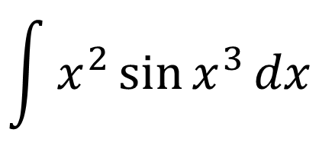
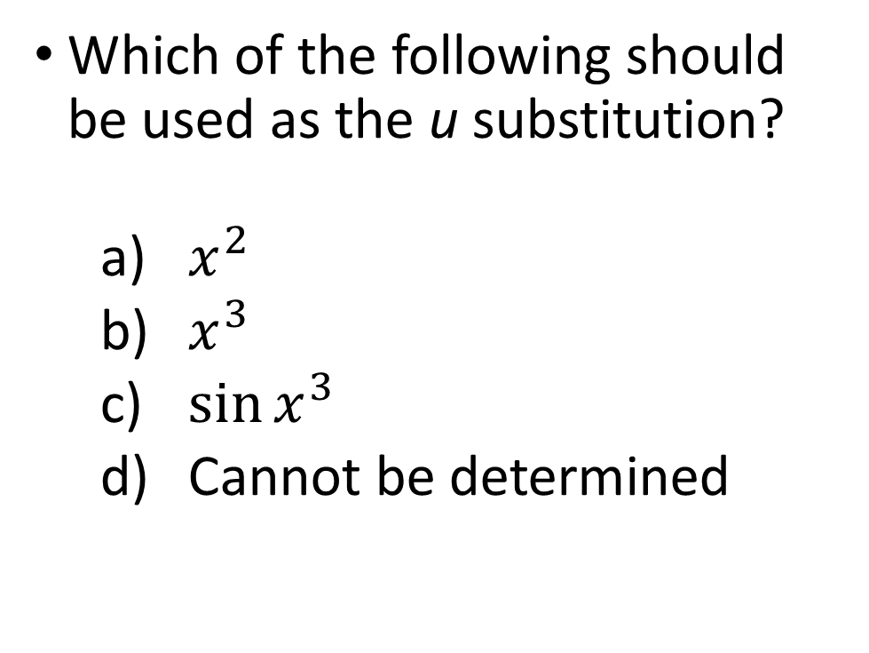
Calculus Example
Which of the following should be used as the u substitution?
  $x^{2}$
  $x^{3}$
  $\sin{x^{3}}$
  Cannot be determined
$$\int{x^{2}\sin{x^{3}}dx}$$
Students practice new topic

Slide 35
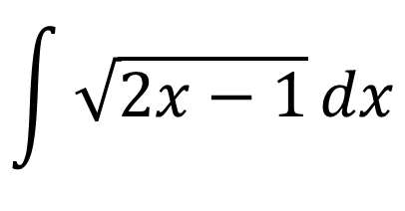
Calculus Example
Which method should be used to determine the integral?
  u substitution
  Log Rule
  Inverse Trig Function
  Cannot be determined
$$\int{\sqrt{2x−1}}dx$$
Make connections after learning several topics

Slide 36
Psychology Example
Read Scenario 1 in the class handout. Select the method of learning is described in the scenario.
  Classical conditioning
  Operant conditioning
  Negative reinforcement
  Positive reinforcement
  Punishment
Students practice new topic

Slide 37
Practice Developing Ready-to-Use Examples

Slide 38
Think of a topic you will teach next week
Does the topic contain any of the following?
  Vocabulary
  Multi-step process
  Elements that students have struggled with in the past
Brainstorm some ideas for implementing a multiple-choice style question that you could use next week.

Slide 39
Think of a topic you taught last week
Does the topic contain any of the following?
  Vocabulary needed for this week
  Basic steps needed for this week or next week
  Elements that students have struggled with in the past
Brainstorm multiple-choice questions that you could use to practice RETRIEVAL this week.

Slide 40
Experiences of Trine University Faculty

Slide 41
Professor K. Rentz
“I like multiple choice questions in class for concept quizzes as it provides a starting point for group discussions. It is a low stress way to let students think about a topic and provides direction for their discussions.”

Slide 42
Professor M. Blaz
“I’ve been using multiple choice questions to practice retrieval. What I like is that it tells me whether they have understood material from a previous lecture.”

Slide 43
Professor T. Murphy
“In my class, I frequently ask a multiple choice question of the same format. The purpose of these questions is to try to have them think about the equations they are using, rather than just plugging in variables and writing a result.”

