Slide 1
Helping Students Increase Cognitive Complexity: Constructivist & Phenomenological Methods
BRETT D. WILKINSON, Ph.D., LMHC
Purdue University Fort Wayne
School of education

Slide 2
HOW TO HELP UNIVERSITY STUDENTS BECOME COMPLEX THINKERS & ADAPTIVE LEARNERS?
“You are an eyewitness to a crime: A man has robbed a bank, but instead of keeping the money for himself, he donates it to a poor orphanage that can now afford to feed, clothe, and care for its children. You know who committed the crime. If you go to the authorities with the information, there's a good chance the money will be returned to the bank, leaving a lot of kids in need. What do you do?”

Slide 3
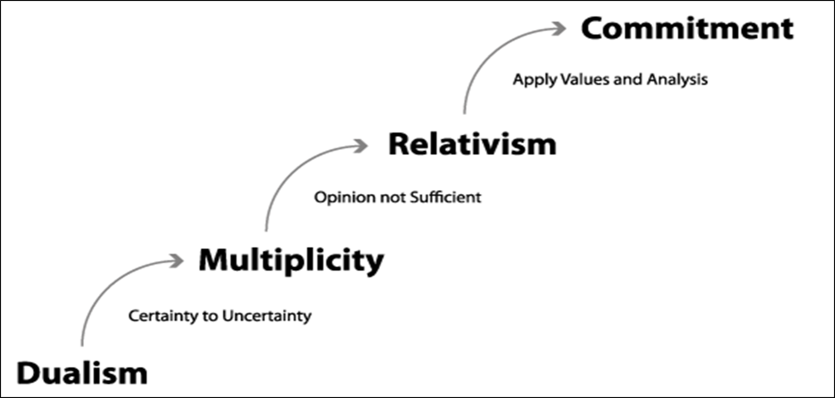
Perry’s Stages of Intellectual Development

Slide 4
Dualism
All robberies are crimes that must be reported
Multiplicity
Question: Are all robberies crimes that must be reported?
The selected action is a matter of personal opinion
Relativism
Question: What are the conditions under which I would make such a decision?
I would act in the following way because…
The man committed a robbery
He thus committed a crime that must be reported
The man committed a robbery, but his intent was unselfish
Deconstruct what it means to commit a crime and apply to context of problem

Slide 5
Dualism
All robberies are crimes that must be reported
Multiplicity
Question: Are all robberies crimes that must be reported?
The selected action is a matter of opinion
Relativism
Question: What are the conditions under which I would make such a decision?
I would act in the following way because…
The man committed a robbery
He thus committed a crime that must be reported
The man committed a robbery, yet his intent was unselfish
Deconstruct what it means to commit a crime and apply to context of problem
Deduction
General Rule
Specific Conclusion
Induction
Specific Observation
Specific Conclusion
Abduction
Incomplete Observations
Best Possible Conclusion
Observation confirms rule
Rule inferred by observation
Inference to the best available explanation
REALISM
CONSTRUCTIVISM
PRAGMATISM/PHENOMENOLOGY

Slide 6
Abduction
Incomplete Observations
Best Possible Conclusion
Inference to the best available explanation
Real World, non-experimental conditions
initial hypothesis formation
Supplements hypothetico-deductive reasoning
Useful when data is insufficient or inconsistent
Ethical dilemmas
Interpersonal processes
Cultural differences

Slide 7
Perry’s Stages of Intellectual Development
PHENOMENOLOGY
Integrative Complexity
CONSTRUCTIVISM
Differentiated Complexity

Slide 9
Constructivism
phenomenology
promotes “exposure to multiplicity”
Operates via differentiated complexity
Discover alternative interpretations to increase the breadth of conceived possibility (i.e.; differentiation).
promotes “exposure to specificity”
Operates via integrative complexity
Eliminate abstract interpretations to discover essential features of lived experiences (i.e., integration).

Slide 10
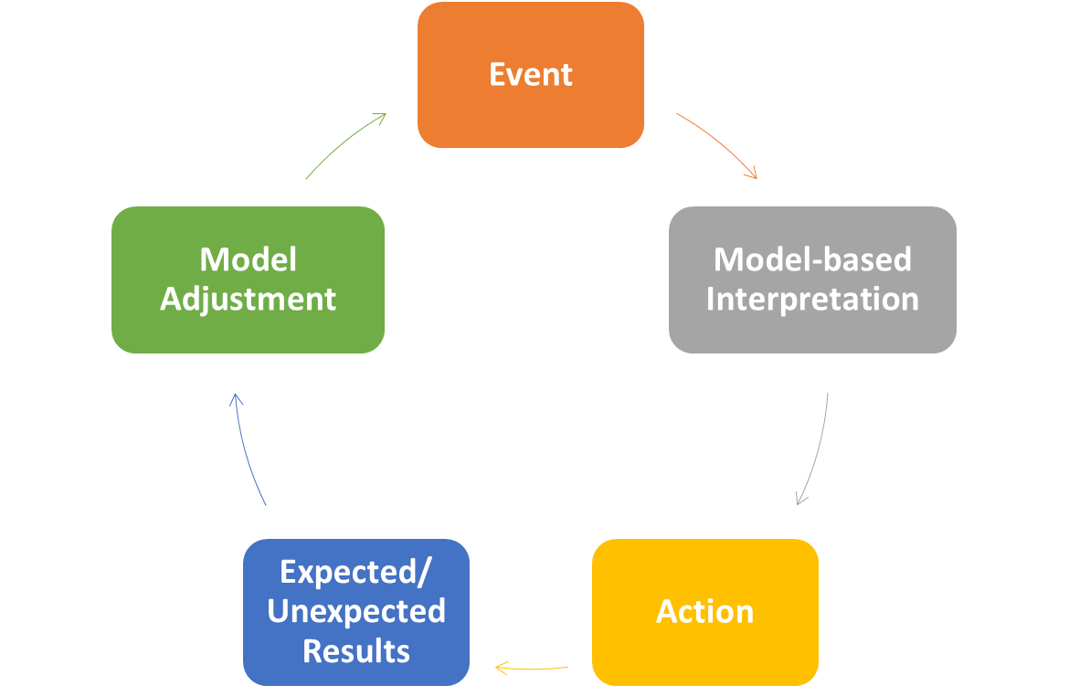
Constructivism: Create more adaptive mental models
Emphasis on the construction of knowledge via interactive and dynamic groupwork:
Collaboration
Experimentation
Research Projects
Class Discussions
Field Trips/Films
i.e., Robust mental models of complex processes learned by means of inductive reasoning

Slide 11
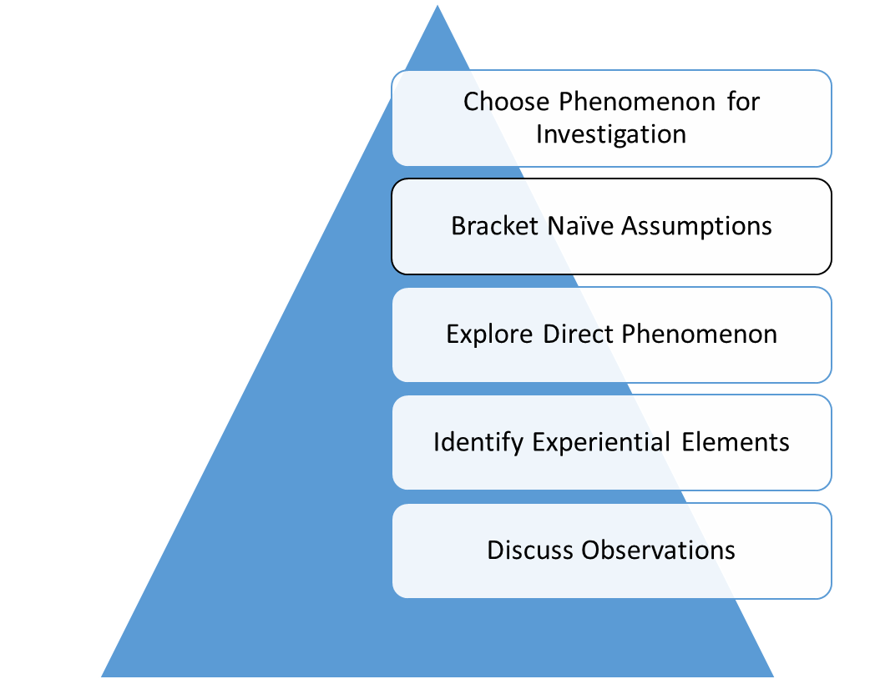
Phenomenology: Confront and examine common truisms
Emphasis on the deconstruction of abstract mental models via an examination of assumptions:
Identify an abstract concept
Examine lived phenomenon to which abstract concept refers
Identify basic features
Collaborate with others to share individual observations
i.e., Highly abstracted concepts that have become unmoored from lived experience can be refined via the phenomenological reduction

Slide 12
Call and response assignment: COUNSELING

Slide 13
Relativism
Question: What are the conditions under which I would make such a decision?
I would act in the following way because…
Deconstruct what it means to commit a crime and apply to context of problem
Step 1 - Deconstruction
What are the defining features of a crime?
Under what conditions might a crime be sanctionable?
What is the relationship between a crime and morality?
Step 2 – contextualization
Based on my deconstruction above, what features of the robin hood ethical dilemma must be considered and/or dismissed in order to make any given decision?
Step 3 – application
Based on my contextualization, I would do X because…

Slide 14
References
Wilkinson, B. D., Saltis, M., & Dewell, J. A. (in press). Promoting cognitive complexity in counselor education: Constructivist and phenomenological practices. Journal of Humanistic Counseling.
Wilkinson, B. D., Shank, G., & Hanna, F. J. (2019). Epistemological issues in counselor preparation: A detailed examination of constructivist and phenomenological assumptions. Journal of Counselor Preparation and Supervision, 12(4).
Wilkinson, B. D. & Dewell, J. A. (2019). Cognitive complexity: Differentiation and integration in counseling practice and training. Journal of Counseling and Development, 97(3), 317-324.
Wilkinson, B. D. & Hanna, F. J. (2016). New horizons in counselor pedagogy: The intersection of constructivist concepts and phenomenological awareness. Journal of Humanistic Counseling, 55(1), 2-19.
Contact Info: Dr. Brett Wilkinson; wilkinsb@pfw.edu

