Slide 1
Assess-Intervene/Innovate-Reassess
Assessing to Improve Student Learning and Success
D. Kent Johnson, PhD

Slide 2
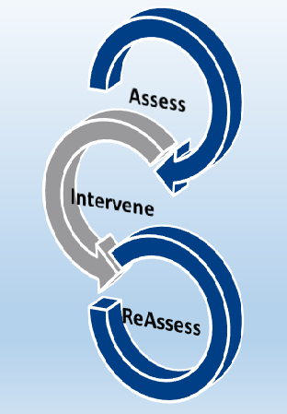
Expected Outcomes of the Workshop
Summarize how current assessment results are used to improve the programs capacity to improve student learning and success.
Identify potential gaps in current assessment plan and/or identify challenges in identifying how assessment results connect to the curriculum

Slide 3
Expected Outcomes of the Workshop
Identify points in student progression to degree completion (or program curriculum) that might provide evidence of an expected level of learning achievement relative to a programmatic SLO.
Align potential assessments of student progress relative to a programmatic SLO to expected levels of learning in core courses.
Design a micro assessment plan to provide evidence of student learning relative to a programmatic SLO at different points in the curriculum

Slide 4
Summarizing Plan for Using Current Assessment Results
Programmatic SLO: After completing the academic program, students (action verb)…
Curricular point/Expected Level of Learning | Planned Assessment | Findings | Intervention or Innovation | Reassess: Assessment of Intervention or Innovation

Slide 5
Assessment Plan in a Course Level SLO Scaffold
Planned embedded assessments at pre-determined curricular points
Programmatic SLO: Students will apply disciplinary conventions to critique a (research article, case study, an artistic performance, a literary piece, a historical analysis, a work of art, etc)
Course Level Outcome | Capstone 4 | Milestones 3 | Milestones 2 | Benchmark 1
200 Level A – Identify models or theories for evaluating artifact |  |  |  | X
200 Level B – Compare attributes of different models or theories |  |  | X
300 Level – analyze or interpret artifact |  | X
400 Level – create a research paper, artistic critique, business plan, etc. | X

Slide 6
Summarizing Plan for Using Current Assessment Results
Programmatic SLO: Students will apply disciplinary conventions to critique a (research article, case study, an artistic performance, a literary piece, a historical analysis, a work of art, etc)
Curricular point/Expected Level of Learning | Planned Assessment | Findings relative to Expectations or Benchmarks (metric) | Intervention or Innovation | Reassess: Assessment of Intervention or Innovation
Benchmark | 200 Level A Assessment | 10% did not meet 50% partially met 40% met | Add group exercise to present multiple models to class | Level A Assessment compare student performance
Milestone 1 | 200 Level B Assessment
Milestone 2 | 300 Level Assessment
Capstone | 400 Level Assessment

Slide 7
Now it is your turn –
Select a programmatic SLO from your program
Programmatic SLO:
Curricular point/Expected Level of Learning | Planned Assessment | Findings | Intervention or Innovation | Reassess: Assessment of Intervention or Innovation

Slide 8
Where might you assess as a student matriculates
Planned embedded assessments at pre-determined curricular points
Programmatic SLO: Students will apply disciplinary conventions to critique a (research article, case study, an artistic performance, a literary piece, a historical analysis, a work of art, etc)
Course Level Outcome | Capstone 4 | Milestones 3 | Milestones 2 | Benchmark 1

Slide 9
Set some benchmark levels of performance for planned assessment as students progress through the curriculum
Programmatic SLO:
Curricular point/Expected Level of Learning | Planned Assessment | Findings relative to Expectations or Benchmarks (metric) | Intervention or Innovation | Reassess: Assessment of Intervention or Innovation
Benchmark
Milestone 1
Milestone 2
Capstone

Slide 10
Wrap-Up: A mini assessment of the workshop using RSQC2
Recall – List (in simple terms) what you think was most important or valuable
Summarize - as many of the important points discussed
Question – What are one or two questions that remain about designing assessments and interventions after today’s workshop
Connect – In one or two sentences connect what we did to how you might work with your department to assess student learning
Comment – Write an evaluative comment about the usefulness of the workshop
Collect – I will summarize the feedback and share it with you after both workshops are complete

